Slide 1
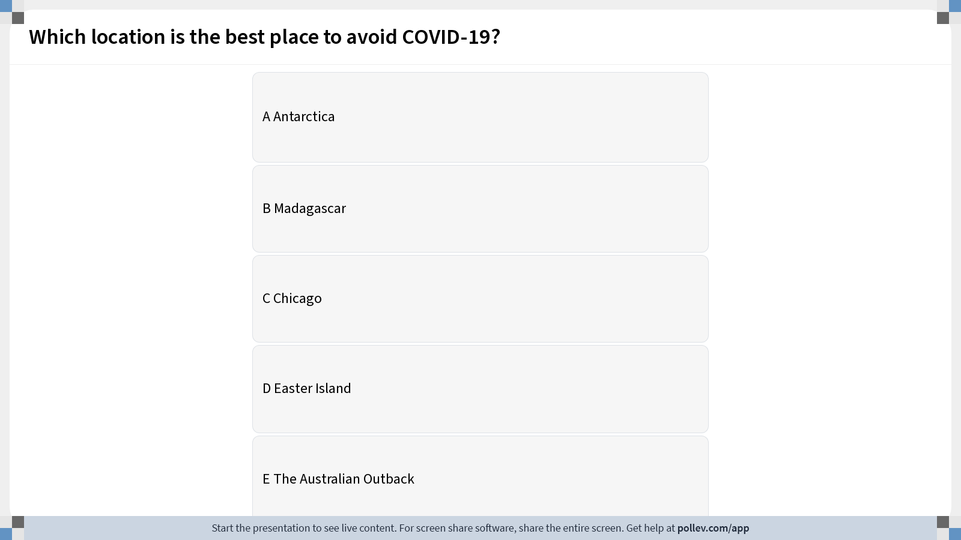
Notes:
Do not modify the notes in this section to avoid tampering with the Poll Everywhere activity. More info at polleverywhere.com/support Which location is the best place to avoid COVID-19?
https://www.polleverywhere.com/multiple_choice_polls/U1q9WrsUPHtwUUAVvSSeN?display_state=instructions&activity_state=opened&state=opened&flow=Engagement&onscreen=persist

Slide 2
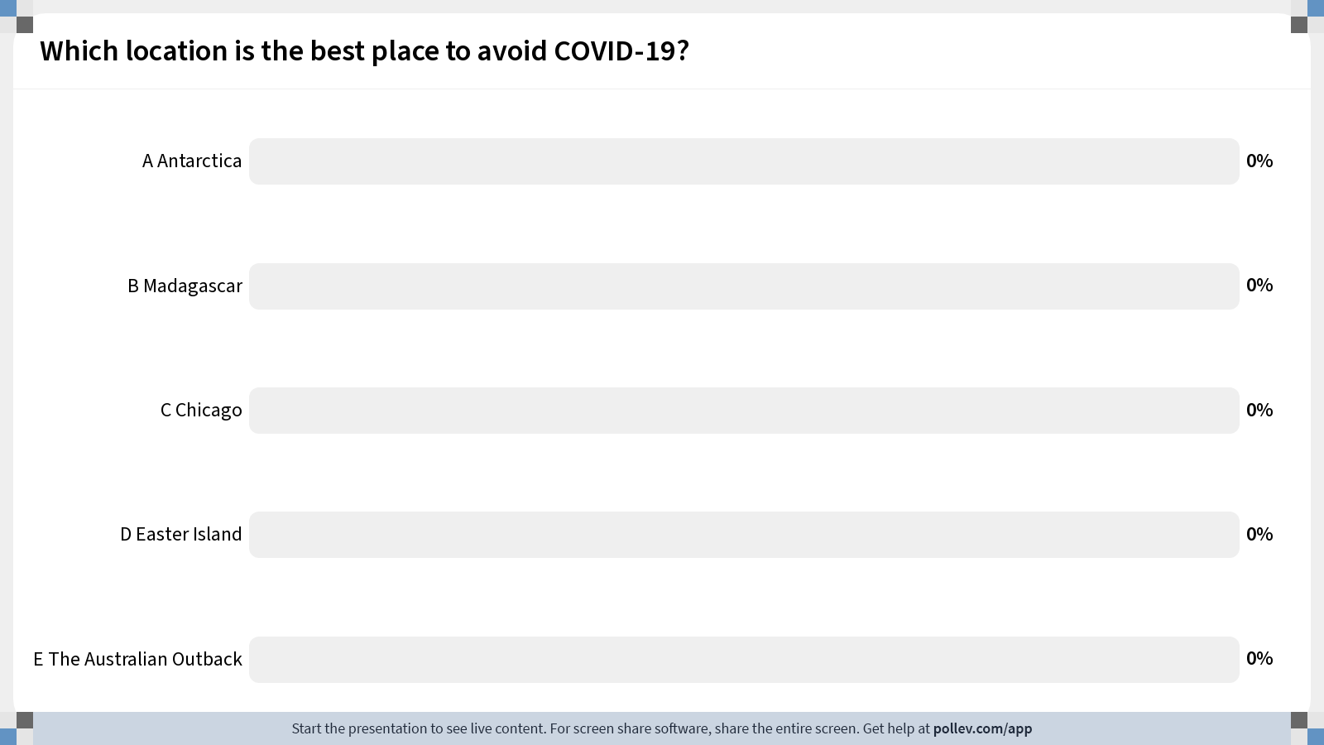
Notes:
Do not modify the notes in this section to avoid tampering with the Poll Everywhere activity. More info at polleverywhere.com/support Which location is the best place to avoid COVID-19?
https://www.polleverywhere.com/multiple_choice_polls/U1q9WrsUPHtwUUAVvSSeN?display_state=chart&activity_state=opened&state=opened&flow=Engagement&onscreen=persist

Slide 3
Notes:
Do not modify the notes in this section to avoid tampering with the Poll Everywhere activity. More info at polleverywhere.com/support Which location is the best place to avoid COVID-19?
https://www.polleverywhere.com/multiple_choice_polls/U1q9WrsUPHtwUUAVvSSeN?display_state=chart&activity_state=closed&state=closed&flow=Engagement&onscreen=persist

Slide 4
Fundamentals of Ecology
Week 8, Ecology Lecture 6
Cara Brook
February 22, 2024

Slide 5
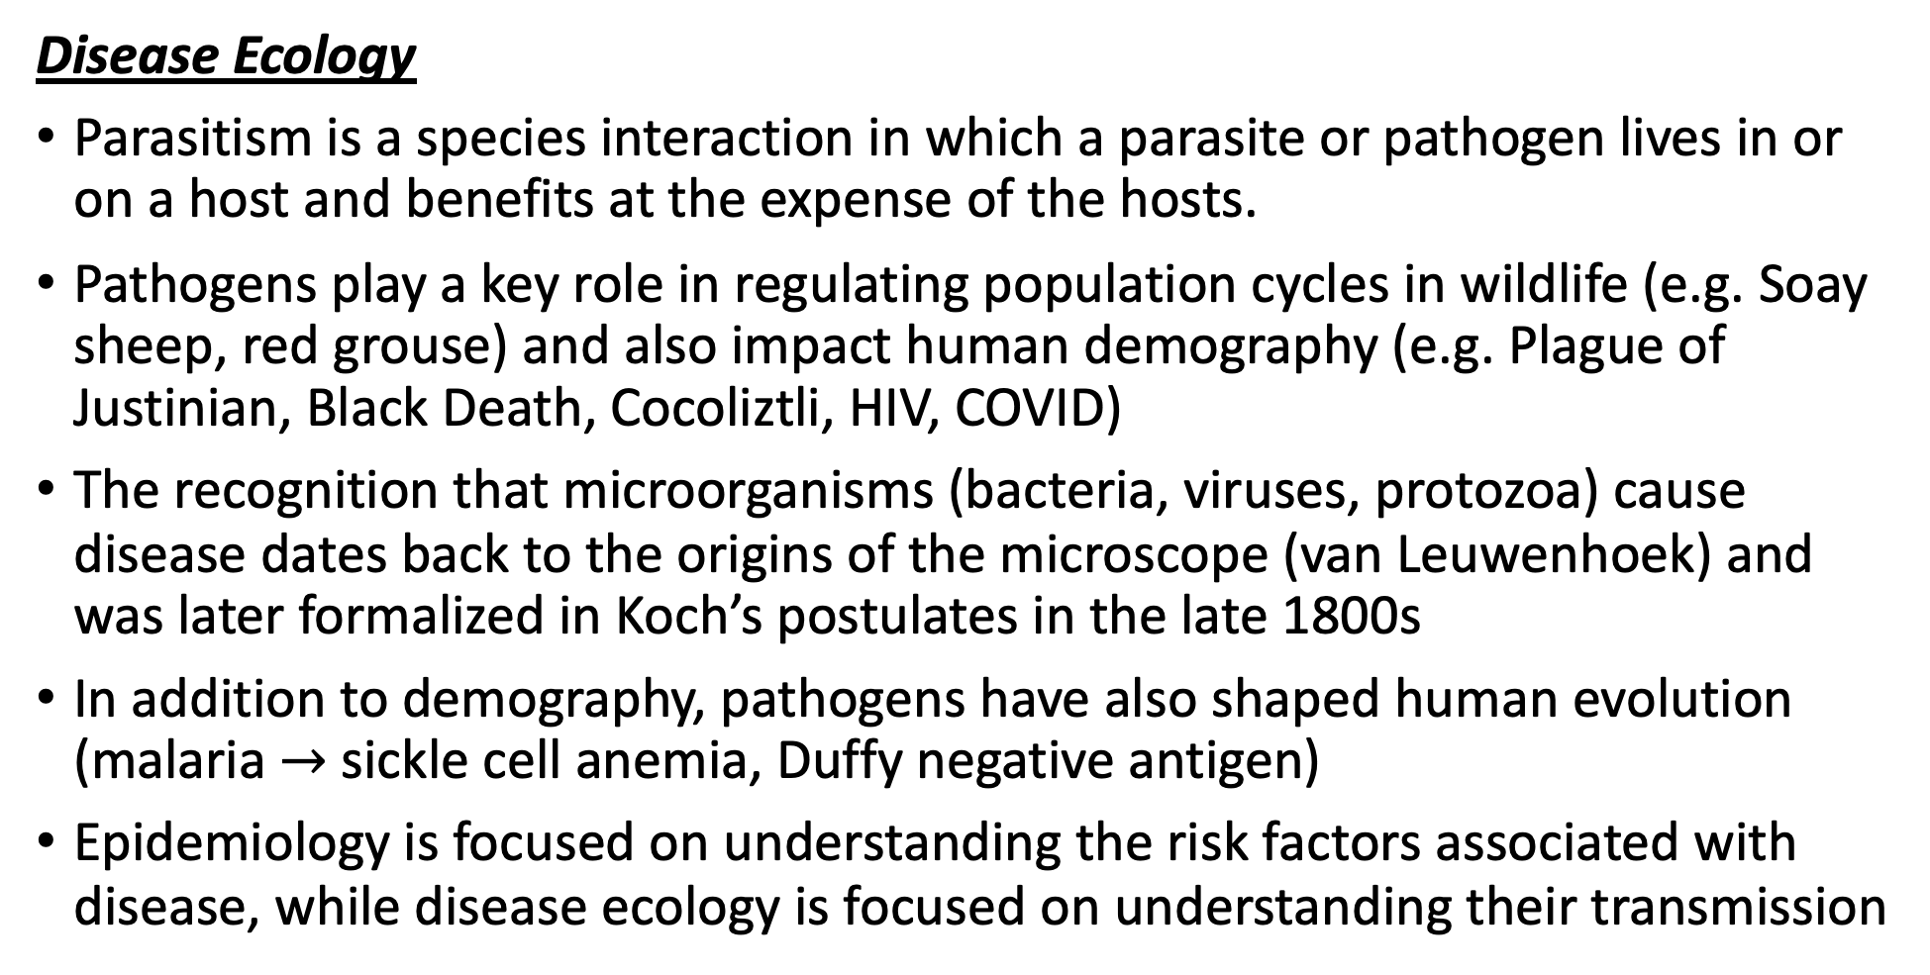
Let’s recap a bit!
Disease Ecology
Parasitism is a species interaction in which a parasite or pathogen lives in or on a host and benefits at the expense of the hosts.
Pathogens play a key role in regulating population cycles in wildlife (e.g. Soay sheep, red grouse) and also impact human demography (e.g. Plague of Justinian, Black Death, Cocoliztli, HIV, COVID)
The recognition that microorganisms (bacteria, viruses, protozoa) cause disease dates back to the origins of the microscope (van Leuwenhoek) and was later formalized in Koch’s postulates in the late 1800s
In addition to demography, pathogens have also shaped human evolution (malaria $→$ sickle cell anemia, Duffy negative antigen)
Epidemiology is focused on understanding the risk factors associated with disease, while disease ecology is focused on understanding their transmission

Slide 6
Let’s recap a bit!
Disease Ecology
Parasitism is a species interaction in which a parasite or pathogen lives in or on a host and benefits at the expense of the hosts.
Pathogens play a key role in regulating population cycles in wildlife (e.g. Soay sheep, red grouse) and also impact human demography (e.g. Plague of Justinian, Black Death, Cocoliztli, HIV, COVID)
The recognition that microorganisms (bacteria, viruses, protozoa) cause disease dates back to the origins of the microscope (van Leuwenhoek) and was later formalized in Koch’s postulates in the late 1800s
In addition to demography, pathogens have also shaped human evolution (malaria $→$ sickle cell anemia, Duffy negative antigen)
Epidemiology is focused on understanding the risk factors associated with disease, while disease ecology is focused on understanding their transmission

Slide 7
Let’s recap a bit!
Disease Ecology
Parasitism is a species interaction in which a parasite or pathogen lives in or on a host and benefits at the expense of the hosts.
Pathogens play a key role in regulating population cycles in wildlife (e.g. Soay sheep, red grouse) and also impact human demography (e.g. Plague of Justinian, Black Death, Cocoliztli, HIV, COVID)
The recognition that microorganisms (bacteria, viruses, protozoa) cause disease dates back to the origins of the microscope (van Leuwenhoek) and was later formalized in Koch’s postulates in the late 1800s
In addition to demography, pathogens have also shaped human evolution (malaria $→$ sickle cell anemia, Duffy negative antigen)
Epidemiology is focused on understanding the risk factors associated with disease, while disease ecology is focused on understanding their transmission

Slide 8
Let’s recap a bit!
Disease Ecology
Parasitism is a species interaction in which a parasite or pathogen lives in or on a host and benefits at the expense of the hosts.
Pathogens play a key role in regulating population cycles in wildlife (e.g. Soay sheep, red grouse) and also impact human demography (e.g. Plague of Justinian, Black Death, Cocoliztli, HIV, COVID)
The recognition that microorganisms (bacteria, viruses, protozoa) cause disease dates back to the origins of the microscope (van Leuwenhoek) and was later formalized in Koch’s postulates in the late 1800s
In addition to demography, pathogens have also shaped human evolution (malaria $→$ sickle cell anemia, Duffy negative antigen)
Epidemiology is focused on understanding the risk factors associated with disease, while disease ecology is focused on understanding their transmission

Slide 9
Let’s recap a bit!
Disease Ecology
Parasitism is a species interaction in which a parasite or pathogen lives in or on a host and benefits at the expense of the hosts.
Pathogens play a key role in regulating population cycles in wildlife (e.g. Soay sheep, red grouse) and also impact human demography (e.g. Plague of Justinian, Black Death, Cocoliztli, HIV, COVID)
The recognition that microorganisms (bacteria, viruses, protozoa) cause disease dates back to the origins of the microscope (van Leuwenhoek) and was later formalized in Koch’s postulates in the late 1800s
In addition to demography, pathogens have also shaped human evolution (malaria $→$ sickle cell anemia, Duffy negative antigen)
Epidemiology is focused on understanding the risk factors associated with disease, while disease ecology is focused on understanding their transmission

Slide 10
Let’s recap a bit!
Disease Ecology
Parasitism is a species interaction in which a parasite or pathogen lives in or on a host and benefits at the expense of the hosts.
Pathogens play a key role in regulating population cycles in wildlife (e.g. Soay sheep, red grouse) and also impact human demography (e.g. Plague of Justinian, Black Death, Cocoliztli, HIV, COVID)
The recognition that microorganisms (bacteria, viruses, protozoa) cause disease dates back to the origins of the microscope (van Leuwenhoek) and was later formalized in Koch’s postulates in the late 1800s
In addition to demography, pathogens have also shaped human evolution (malaria $→$ sickle cell anemia, Duffy negative antigen)
Epidemiology is focused on understanding the risk factors associated with disease, while disease ecology is focused on understanding their transmission

Slide 11
Let’s recap a bit!
Disease Ecology
We model transmission dynamics using the Susceptible-Infected-Recovered (SIR) model, where hosts are classed according to their infectious status.
R₀, the basic reproduction number for a pathogen, describes the number of new infections generated by a single infection in a completely susceptible population. It is expressed with the terms of infections gained / infections lost.
RE, or Rt, is the effective reproduction number. It is R₀*the proportion susceptible. Epidemics grow at R_{E}>1 and decline at R_{E}<1.
We can leverage this RE equation to describe the proportion of the population needed to vaccinate to eradicate a pathogen: PV = 1 – 1/R0
Vaccination dates back to antiquity but does not work equally well for all pathogen types and faces many challenges because most pathogens do not follow the simplistic dynamics of measles.

Slide 12
Let’s recap a bit!
Disease Ecology
We model transmission dynamics using the Susceptible-Infected-Recovered (SIR) model, where hosts are classed according to their infectious status.
R₀, the basic reproduction number for a pathogen, describes the number of new infections generated by a single infection in a completely susceptible population. It is expressed with the terms of infections gained / infections lost.
RE, or Rt, is the effective reproduction number. It is R₀*the proportion susceptible. Epidemics grow at R_{E}>1 and decline at R_{E}<1.
We can leverage this RE equation to describe the proportion of the population needed to vaccinate to eradicate a pathogen: PV = 1 – 1/R0
Vaccination dates back to antiquity but does not work equally well for all pathogen types and faces many challenges because most pathogens do not follow the simplistic dynamics of measles.

Slide 13
Let’s recap a bit!
Disease Ecology
We model transmission dynamics using the Susceptible-Infected-Recovered (SIR) model, where hosts are classed according to their infectious status.
R₀, the basic reproduction number for a pathogen, describes the number of new infections generated by a single infection in a completely susceptible population. It is expressed with the terms of infections gained / infections lost.
RE, or Rt, is the effective reproduction number. It is R₀*the proportion susceptible. Epidemics grow at R_{E}>1 and decline at R_{E}<1.
We can leverage this RE equation to describe the proportion of the population needed to vaccinate to eradicate a pathogen: PV = 1 – 1/R0
Vaccination dates back to antiquity but does not work equally well for all pathogen types and faces many challenges because most pathogens do not follow the simplistic dynamics of measles.

Slide 14
Let’s recap a bit!
Disease Ecology
We model transmission dynamics using the Susceptible-Infected-Recovered (SIR) model, where hosts are classed according to their infectious status.
R₀, the basic reproduction number for a pathogen, describes the number of new infections generated by a single infection in a completely susceptible population. It is expressed with the terms of infections gained / infections lost.
RE, or Rt, is the effective reproduction number. It is R₀*the proportion susceptible. Epidemics grow at R_{E}>1 and decline at R_{E}<1.
We can leverage this RE equation to describe the proportion of the population needed to vaccinate to eradicate a pathogen: PV = 1 – 1/R0
Vaccination dates back to antiquity but does not work equally well for all pathogen types and faces many challenges because most pathogens do not follow the simplistic dynamics of measles.

Slide 15
Let’s recap a bit!
Disease Ecology
We model transmission dynamics using the Susceptible-Infected-Recovered (SIR) model, where hosts are classed according to their infectious status.
R₀, the basic reproduction number for a pathogen, describes the number of new infections generated by a single infection in a completely susceptible population. It is expressed with the terms of infections gained / infections lost.
RE, or Rt, is the effective reproduction number. It is R₀*the proportion susceptible. Epidemics grow at R_{E}>1 and decline at R_{E}<1.
We can leverage this RE equation to describe the proportion of the population needed to vaccinate to eradicate a pathogen: P_{V} = 1 – 1/R₀
Vaccination dates back to antiquity but does not work equally well for all pathogen types and faces many challenges because most pathogens do not follow the simplistic dynamics of measles.

Slide 16
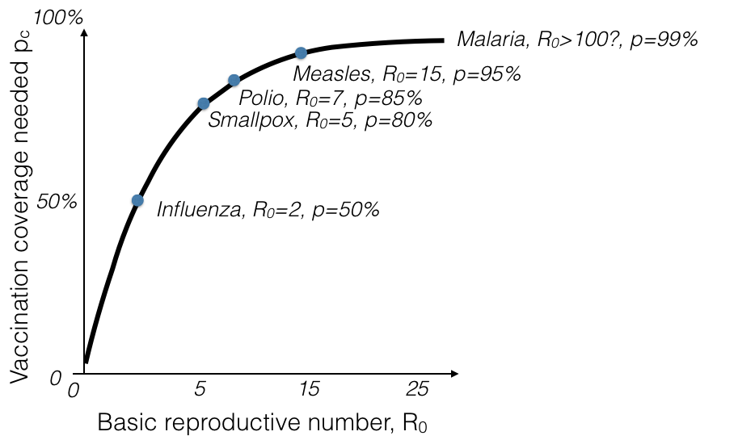
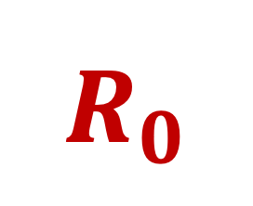
$$R_{0}$$
and the Herd Immunity Threshold
Herd immunity threshold (HIT)
The more transmissible the disease, the higher the HIT!

Slide 17
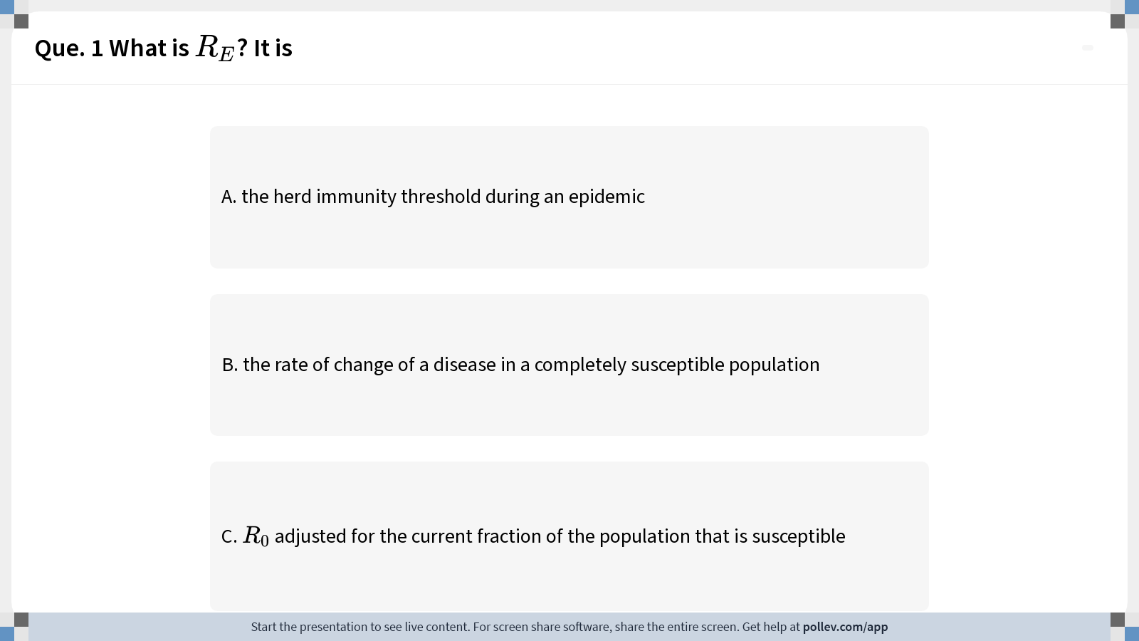
Notes:
Do not modify the notes in this section to avoid tampering with the Poll Everywhere activity. More info at polleverywhere.com/support Que. 1 What is $$R_E$$? It is
https://www.polleverywhere.com/multiple_choice_polls/iWjQhtXRzDFHLiYuE4vqK?display_state=instructions&activity_state=opened&state=opened&flow=Instructor&onscreen=persist

Slide 18
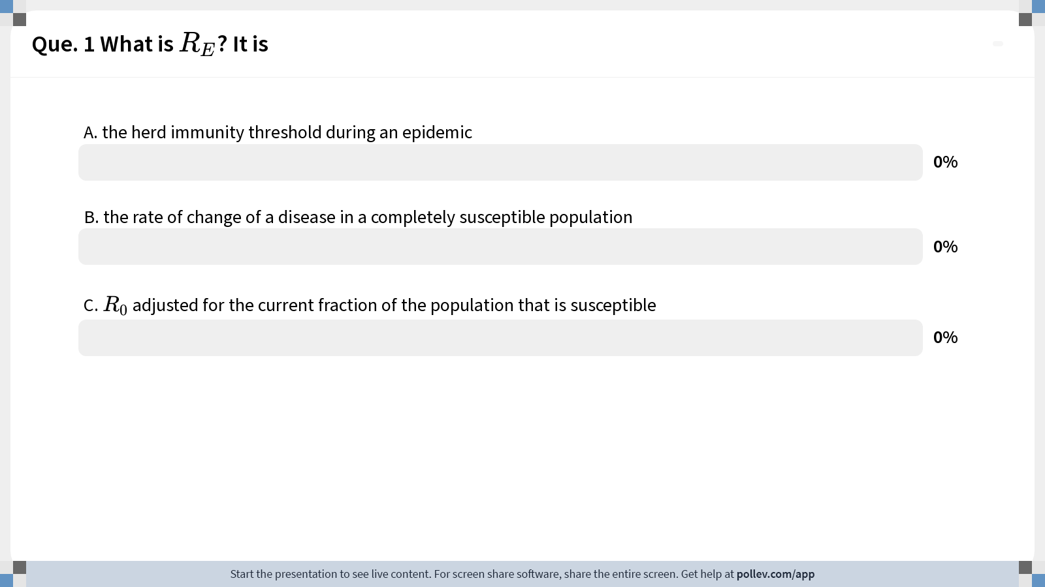
Notes:
Do not modify the notes in this section to avoid tampering with the Poll Everywhere activity. More info at polleverywhere.com/support Que. 1 What is $$R_E$$? It is
https://www.polleverywhere.com/multiple_choice_polls/iWjQhtXRzDFHLiYuE4vqK?display_state=chart&activity_state=closed&state=closed&flow=Instructor&onscreen=persist

Slide 19
Notes:
Do not modify the notes in this section to avoid tampering with the Poll Everywhere activity. More info at polleverywhere.com/support Que. 1 What is $$R_E$$? It is
https://www.polleverywhere.com/multiple_choice_polls/iWjQhtXRzDFHLiYuE4vqK?display_state=chart&activity_state=closed&display=correctness&state=closed&flow=Instructor&onscreen=persist

Slide 20



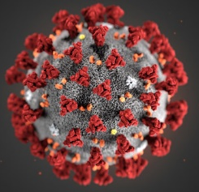
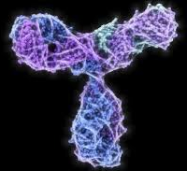
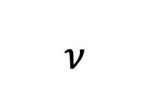
Vaccination stems from a long history
$$ν$$
β
γ
S
Susceptible
I
Infectious
R
Removed
“antibody positive”
“seropositive”

Slide 21
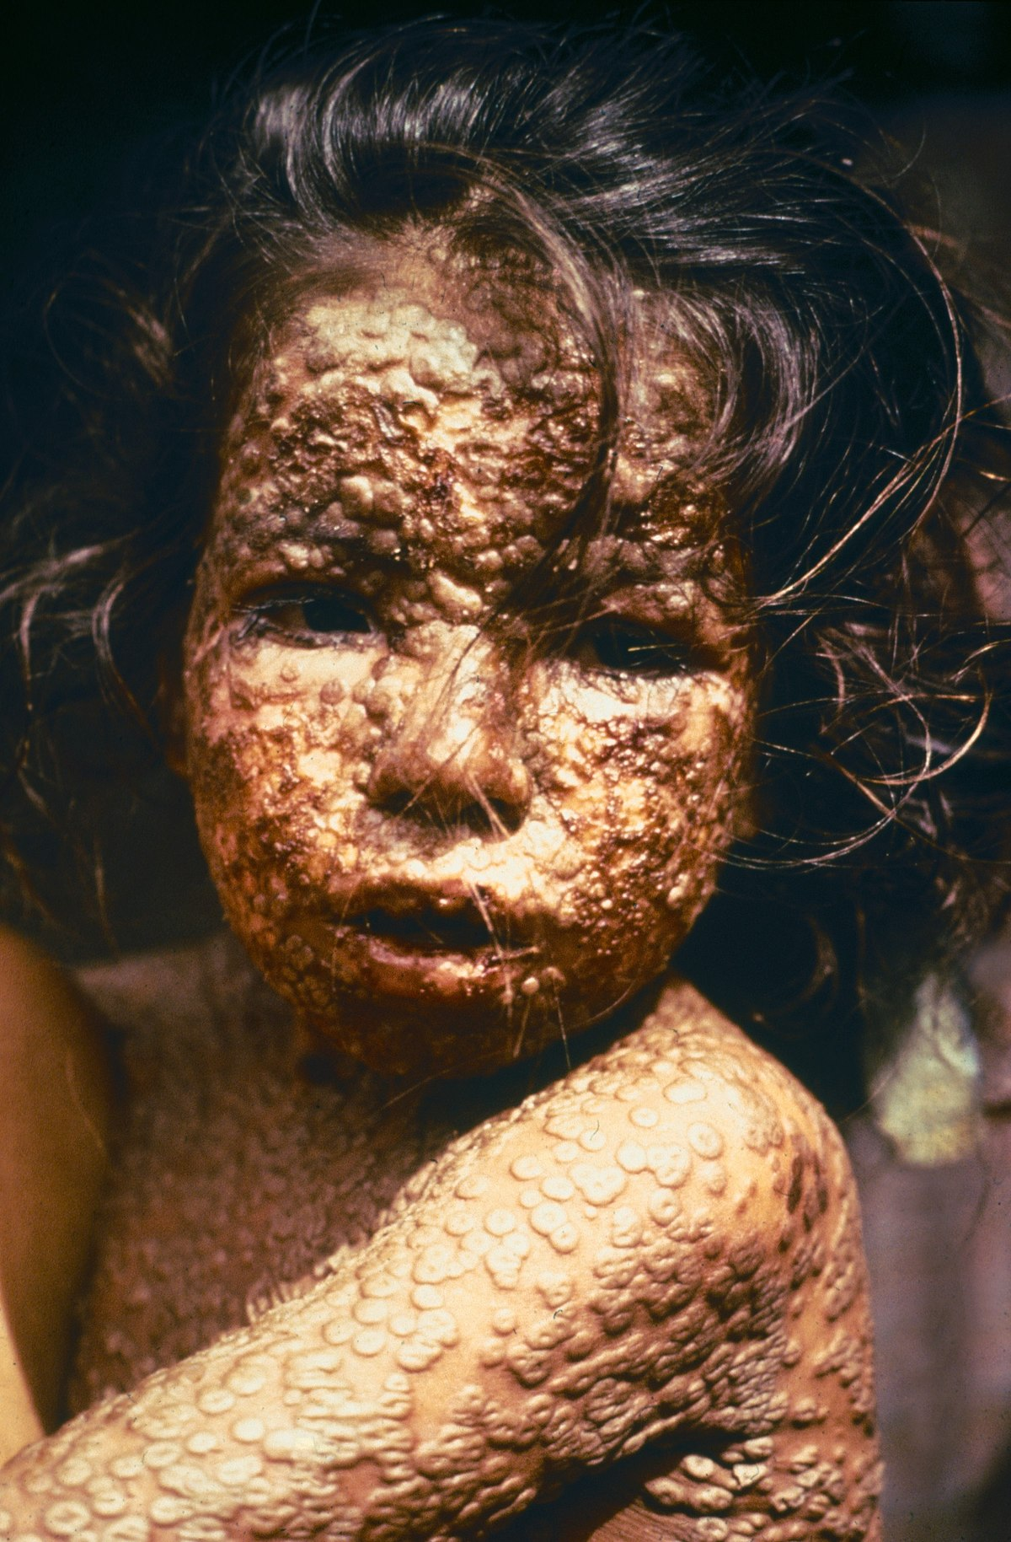
Vaccination stems from a long history
Variolation: Early attempts to provide protection against smallpox (Variola) via inoculation with scab material from a recent patient infected with Variola minor
First described in China in the 10th century
Caused 1% mortality!
1789 Edward Jenner used cowpox vesicles to inoculate an 8-year-old boy
Later inoculated with smallpox and boy was unaffected
The first vaccine, taken from vacca, cow in Latin
Smallpox was globally eradicated in 1977, following a massive international campaign
Today, we are seeing enhanced transmission of monkeypox partly resulting from a lack of circulating immunity to closely related smallpox

Slide 22
Vaccination stems from a long history
Variolation: Early attempts to provide protection against smallpox (Variola) via inoculation with scab material from a recent patient infected with Variola minor
First described in China in the 10th century
Caused 1% mortality!
1789 Edward Jenner used cowpox vesicles to inoculate an 8-year-old boy
Later inoculated with smallpox and boy was unaffected
The first vaccine, taken from vacca, cow in Latin
Smallpox was globally eradicated in 1977, following a massive international campaign
Today, we are seeing enhanced transmission of monkeypox partly resulting from a lack of circulating immunity to closely related smallpox

Slide 23
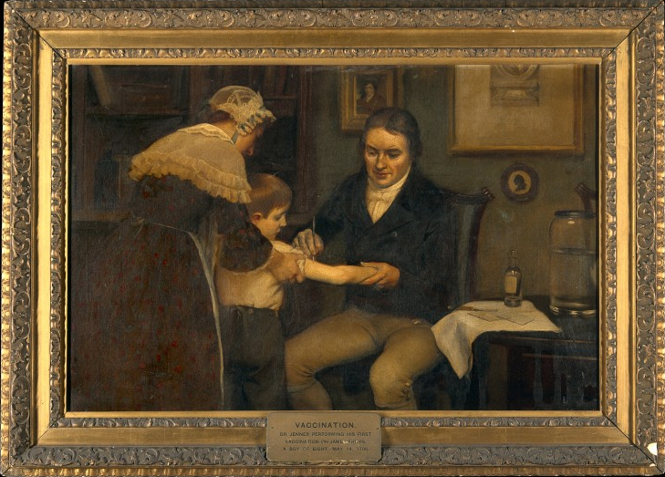
Vaccination stems from a long history
Variolation: Early attempts to provide protection against smallpox (Variola) via inoculation with scab material from a recent patient infected with Variola minor
First described in China in the 10th century
Caused 1% mortality!
1789 Edward Jenner used cowpox vesicles to inoculate an 8-year-old boy
Later inoculated with smallpox and boy was unaffected
The first vaccine, taken from vacca, cow in Latin
Smallpox was globally eradicated in 1977, following a massive international campaign
Today, we are seeing enhanced transmission of monkeypox partly resulting from a lack of circulating immunity to closely related smallpox

Slide 24
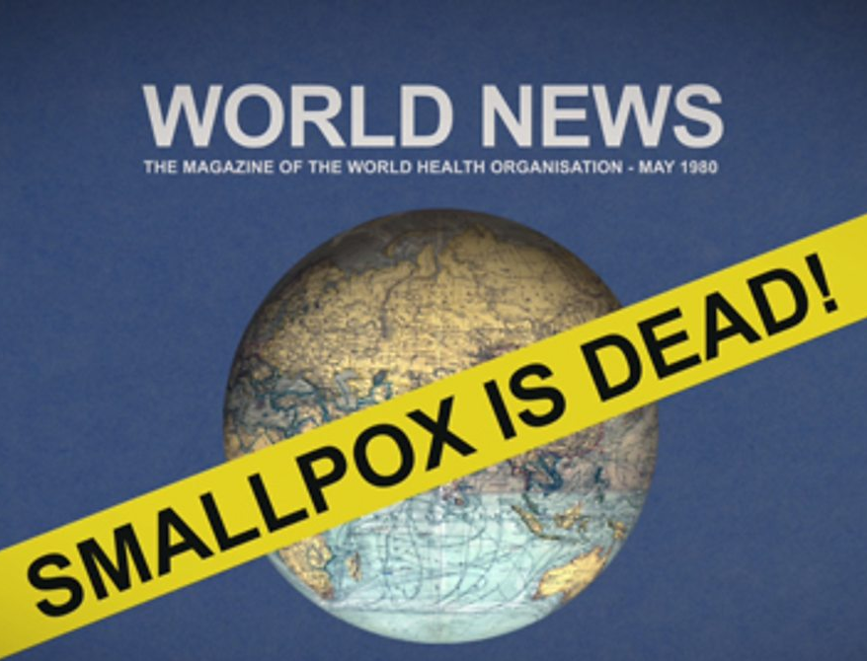
Vaccination stems from a long history
Variolation: Early attempts to provide protection against smallpox (Variola) via inoculation with scab material from a recent patient infected with Variola minor
First described in China in the 10th century
Caused 1% mortality!
1789 Edward Jenner used cowpox vesicles to inoculate an 8-year-old boy
Later inoculated with smallpox and boy was unaffected
The first vaccine, taken from vacca, cow in Latin
Smallpox was globally eradicated in 1977, following a massive international campaign
Today, we are seeing enhanced transmission of monkeypox partly resulting from a lack of circulating immunity to closely related smallpox

Slide 25
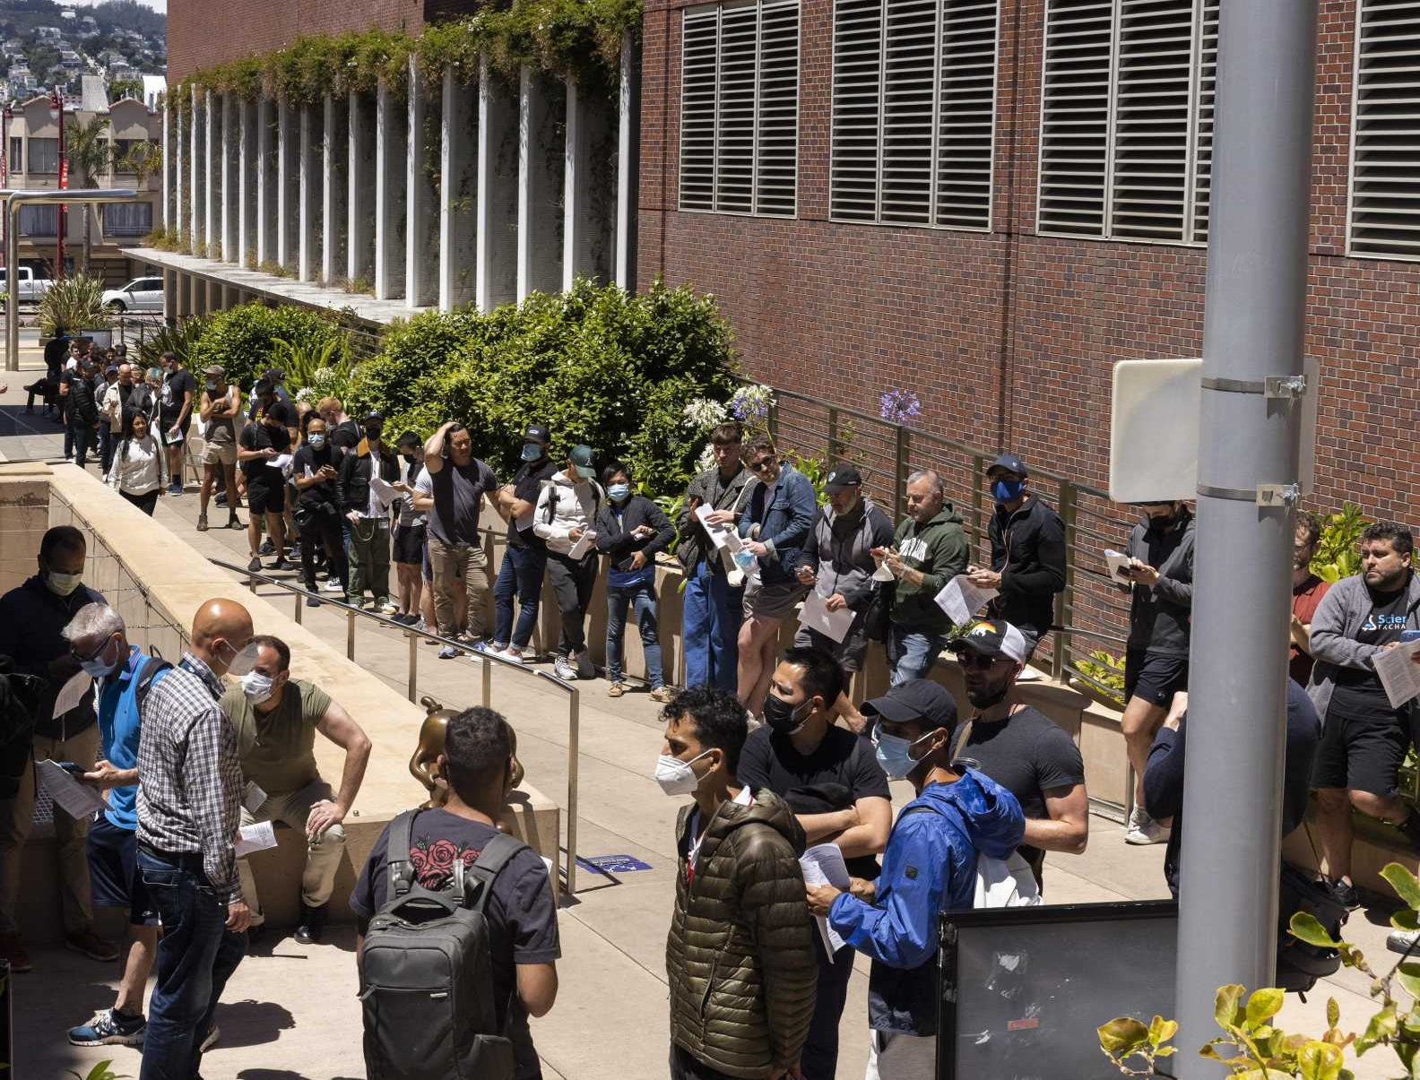
Vaccination stems from a long history
Variolation: Early attempts to provide protection against smallpox (Variola virus) via inoculation with scab material from a recent patient infected with Variola minor
First described in China in the 10th century
Caused 1% mortality!
1789 Edward Jenner used cowpox vesicles to inoculate an 8-year-old boy
Later inoculated with smallpox and boy was unaffected
The first vaccine, taken from vacca, cow in Latin
Smallpox was globally eradicated in 1977, following a massive international campaign
Today, we are seeing enhanced transmission of monkeypox partly resulting from a lack of circulating immunity to closely related smallpox

Slide 26
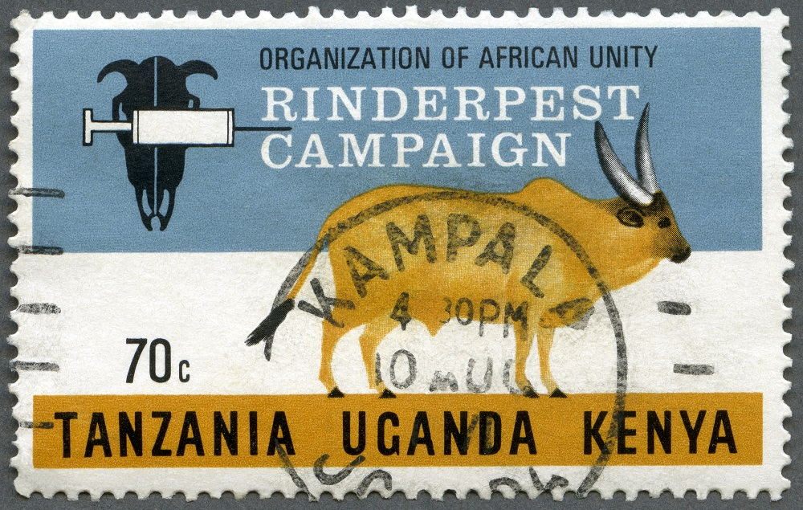
Only two global vaccination success stories
Notes:
And the second resulted in eradication of rinderpest, a morbillivirus that infects cattle and has decimated agricultural production since antiquity (indeed, rinderpest is thought to have been one of the famed 10 plagues of Egypt and is described in early Roman texts). Rinderpest was declared to be globally eradicated in 2011, though the earliest inoculation efforts date back to the mid-1700s. Vaccine stocks are still held globally because cattle would be highly susceptible to infection were a resurgence to occur. The same is true for smallpox, and recent circulation of monkeypox underlines this susceptibility, as smallpox vaccine is cross-protective.

Slide 27
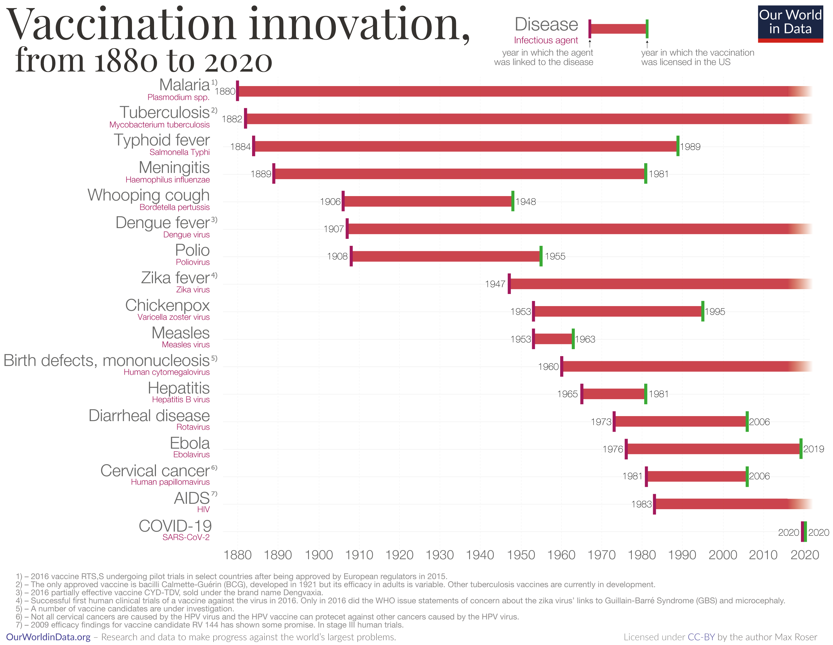
The pace of vaccine development has accelerated drastically

Slide 28
But we still lack vaccines for several important diseases.

Slide 29
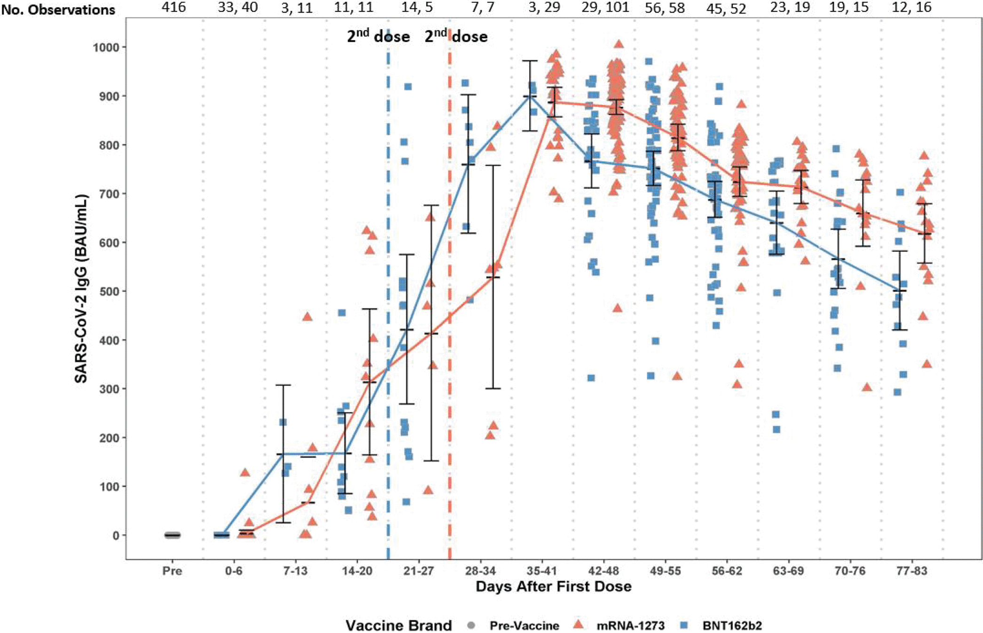
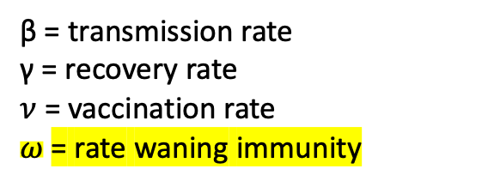

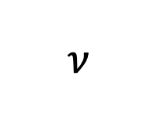
Challenges to Vaccination
Imperfect immunity, especially with non-viral pathogens
Geographic differences in public health policy and access
Continuous births
Animal reservoirs
Spatial structure (metapopulation rescue)
$$ν$$
β
γ
S
Susceptible
I
Infectious
R
Removed
$$ω$$
β = transmission rate
γ = recovery rate
$ν$ = vaccination rate
$ω$= rate waning immunity
Montoya et al. 2021 Microbiology Spectrum

Slide 30
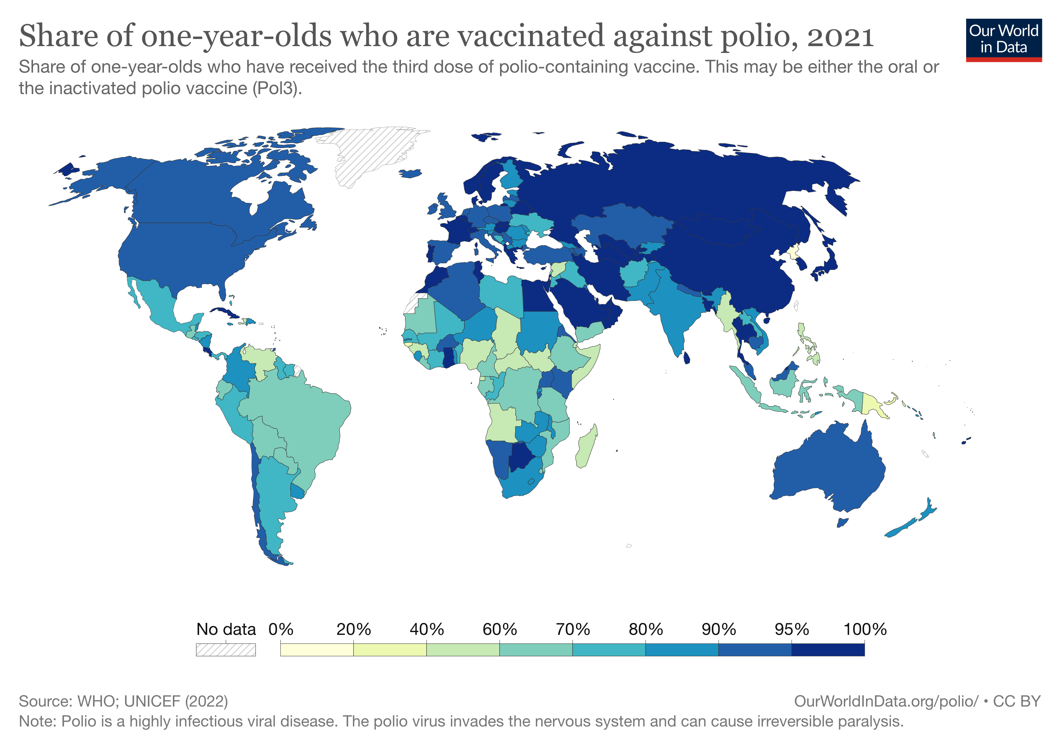
Challenges to Vaccination
Imperfect immunity, especially with non-viral pathogens
Geographic differences in public health policy and access
Continuous births
Animal reservoirs
Spatial structure (metapopulation rescue)

Slide 31
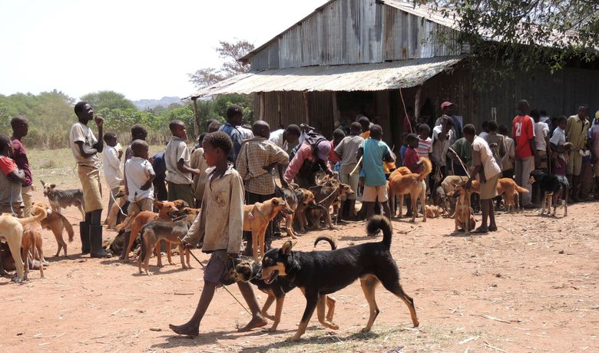
Challenges to Vaccination
Imperfect immunity, especially with non-viral pathogens
Geographic differences in public health policy and access
Continuous births
Animal reservoirs
Spatial structure (metapopulation rescue)

Slide 32
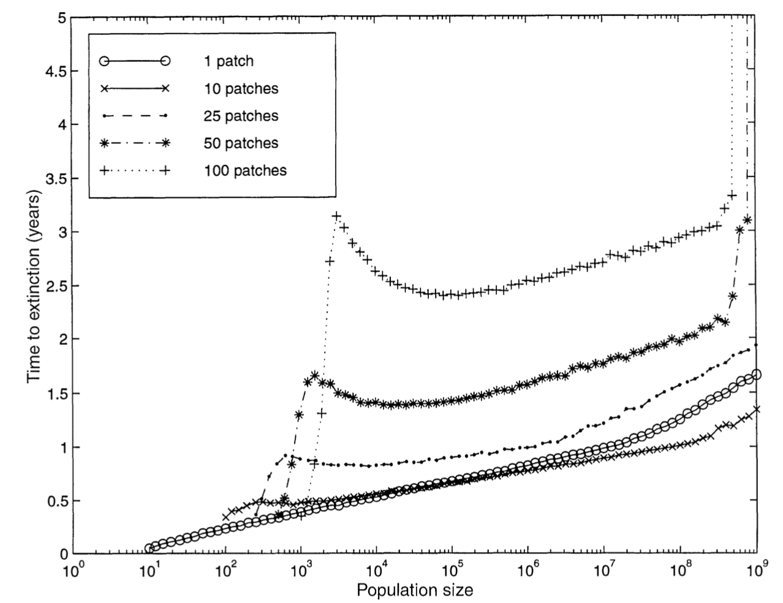
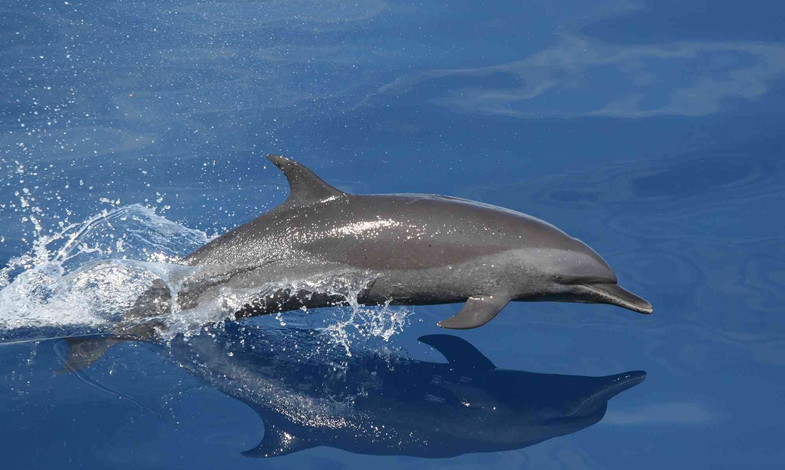
Challenges to Vaccination
Imperfect immunity, especially with non-viral pathogens
Geographic differences in public health policy and access
Continuous births
Animal reservoirs
Spatial structure (metapopulation rescue)
Swinton et al. 1998
Bartlett 1957

Slide 33
Challenges to Vaccination
Imperfect immunity, especially with non-viral pathogens
Geographic differences in public health policy and access
Continuous births
Animal reservoirs
Spatial structure (metapopulation rescue)
More complex pathogens!

Slide 34
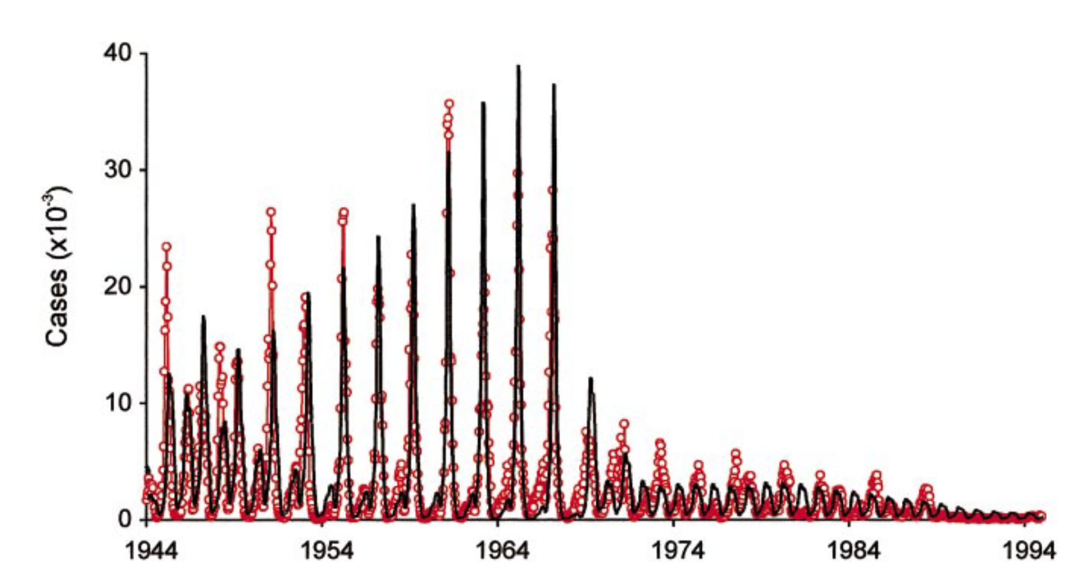
Much of the mathematical theory underlying vaccination was first developed for measles
measles vaccine introduced, 1965
Shift towards more frequent cycling in post-vaccination era. Dynamics more difficult to predict.
model
Biennial cycles in pre-vaccine era measles cases in London
data
Grenfell et al. 2002. Ecological Monographs

Slide 35
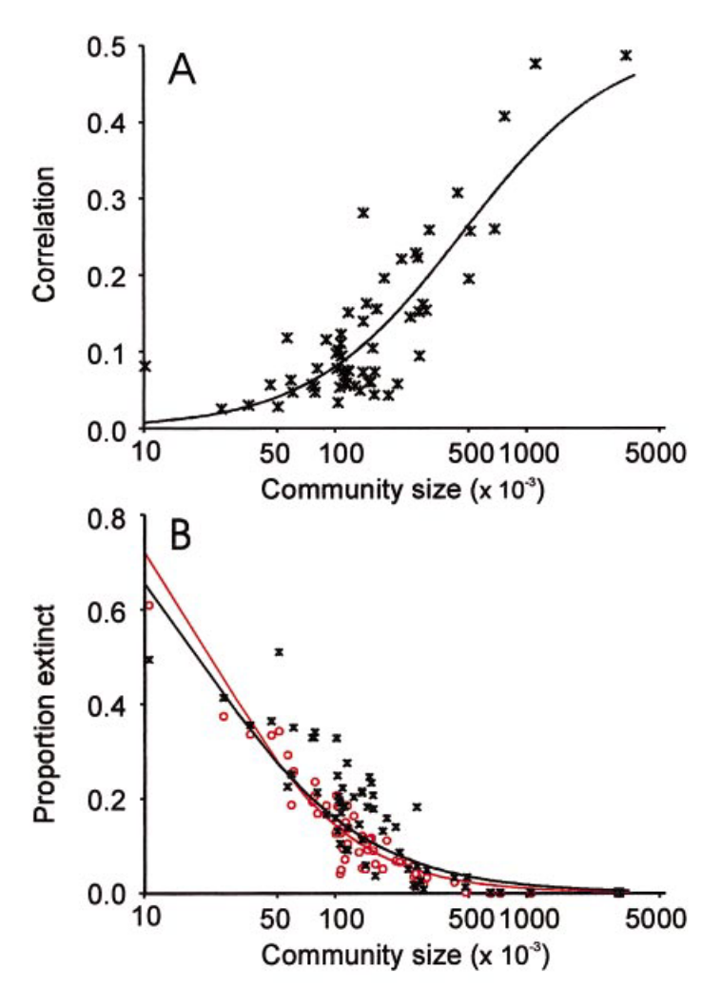
Even for measles, stochastic dynamics mean that predictions become more challenging at smaller population sizes.
Grenfell et al. 2002. Ecological Monographs

Slide 36

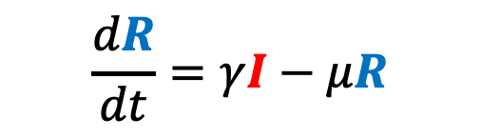

We can adapt the simple SIR model to better match our pathogen of interest and our corresponding data.
$$\frac{dS}{dt}=b(S+I+R)−βSI−μS$$
μ
μ
μ
$$\frac{dI}{dt}=βSI−γI−μI$$
β
γ
b
S
Susceptible
I
Infectious
R
Recovered
$$\frac{dR}{dt}=γI−μR$$

Slide 37

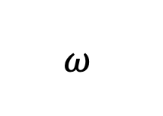
Incorporating Maternal Immunity
μ
b
μ
μ
μ
$$ω$$
β
γ
b
M
Maternally immune
S
Susceptible
I
Infectious
R
Recovered

Slide 38


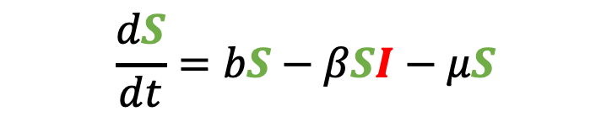
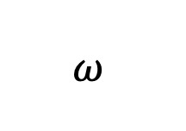
Incorporating Maternal Immunity
μ
b
μ
μ
μ
$$\frac{dS}{dt}=bS−βSI−μS$$
$$ω$$
β
γ
b
M
Maternally immune
S
Susceptible
I
Infectious
R
Recovered
$$\frac{dI}{dt}=βSI−γI−μI$$
$$\frac{dR}{dt}=γI−μR$$
What does our new equation look like?

Slide 39
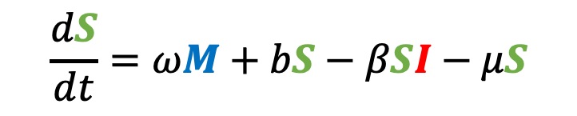
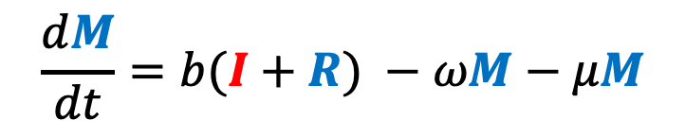
Incorporating Maternal Immunity
$$\frac{dM}{dt}=b(I+R) −ωM−μM$$
μ
b
μ
μ
μ
$$\frac{dS}{dt}=ωM+bS−βSI−μS$$
$$ω$$
β
γ
b
M
Maternally immune
S
Susceptible
I
Infectious
R
Recovered
$$\frac{dI}{dt}=βSI−γI−μI$$
$$\frac{dR}{dt}=γI−μR$$

Slide 40
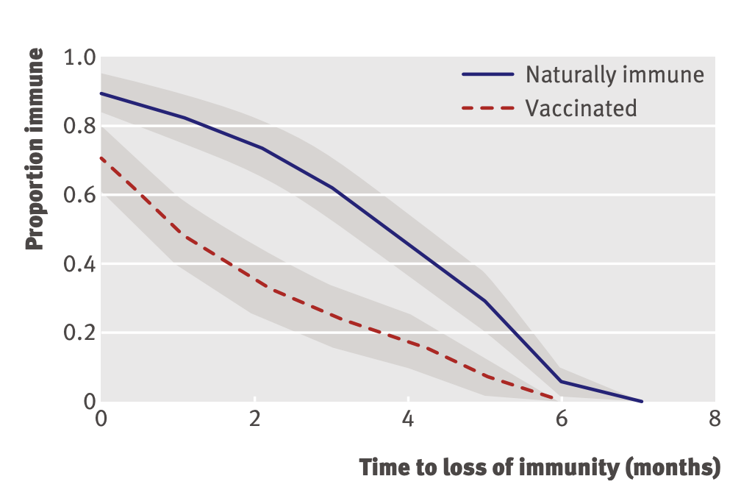
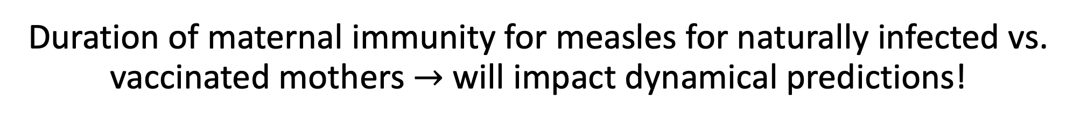
Duration of maternal immunity for measles for naturally infected vs. vaccinated mothers $→$ will impact dynamical predictions!
incorporating maternal immunity
Leuridan et al. 2010. BMJ.

Slide 41
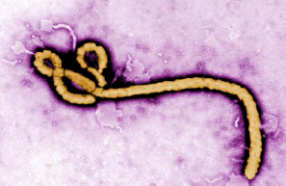
Pathogens exhibit diverse transmission mechanisms that require tailored modeling structures
Directly-transmitted diseases are transmitted via exchange of bodily fluids
Droplet (> 5 microns ) spread or direct contact
Includes sexually-transmitted pathogens, though often modeled with a more complex contact network
Smallpox (Variola spp.), HIV, Mononucleosis (Epstein Barr virus)
Indirectly-transmitted diseases are transmitted via droplets retained in air
Droplets < 5 microns in diameter
Measles, COVID (SARS-CoV-2)
μ
μ
μ
b
β
γ
S
I
R

Slide 42
Pathogens exhibit diverse transmission mechanisms that require tailored modeling structures
Environmentally-transmitted pathogens are transmitted outside of the host (e.g. water-borne, food-borne)
Examples: Cholera (Vibrio cholerae), Salmonellosis (Salmonella spp. bacteria), White-Nosed Syndrome (Pseudogymnoascus destructans)

Slide 43
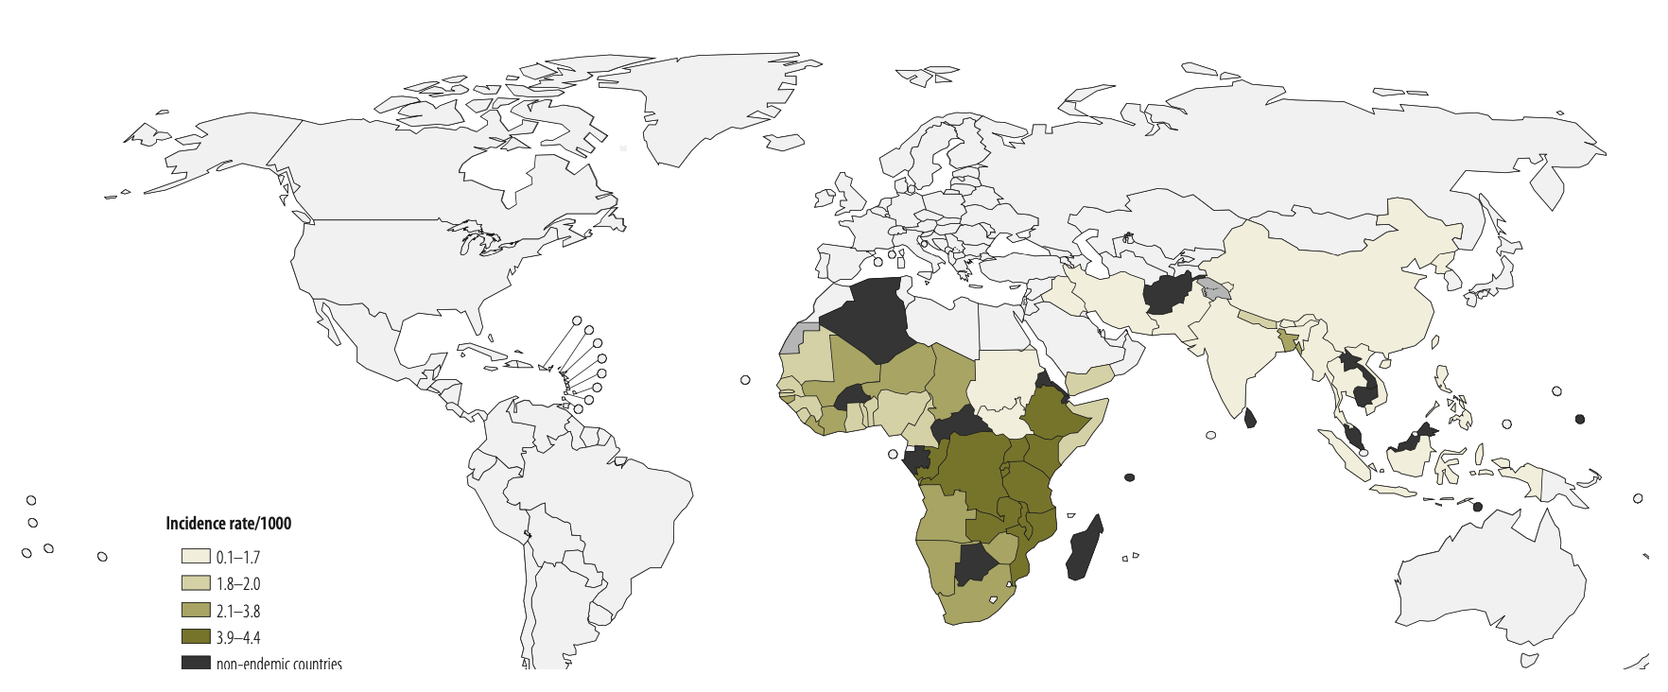
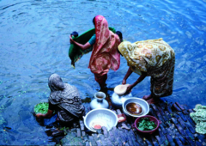
Pathogens exhibit diverse transmission mechanisms that require tailored modeling structures
Environmentally-transmitted pathogens are transmitted outside of the host (e.g. water-borne, food-borne)
Examples: Cholera (Vibrio cholerae), Salmonellosis (Salmonella spp. bacteria), White-Nosed Syndrome (Pseudogymnoascus destructans)
Global Burden of Cholera, 2012
Estimated 2.8 million cases & 95,000 deaths annually
Ali et al. 2012. WHO Bulletin.

Slide 44
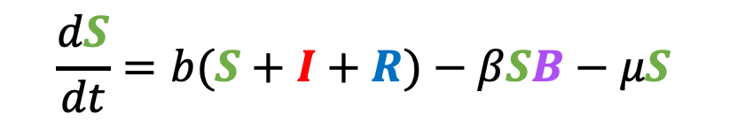
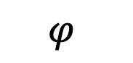
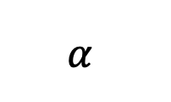
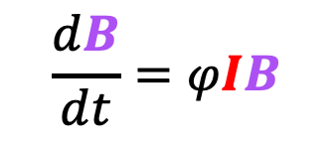
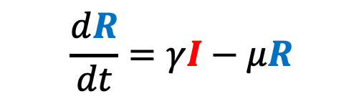
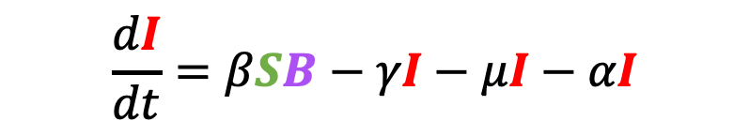
Pathogens exhibit diverse transmission mechanisms that require tailored modeling structures
Environmentally-transmitted pathogens are transmitted outside of the host (e.g. water-borne, food-borne)
Examples: Cholera (Vibrio cholerae), Salmonellosis (Salmonella spp. bacteria), White-Nosed Syndrome (Pseudogymnoascus destructans)
Here, the environmental reservoir is often modeled as its own population
μ
$$α$$
μ
μ
$$\frac{dB}{dt}=φIB$$
γ
b
β
S
I
R
$$\frac{dS}{dt}=b(S+I+R)−βSB−μS$$
$$\frac{dI}{dt}=βSB−γI−μI−αI$$
cholera environmental reservoir
$$φ$$
B
Bacteria
$$\frac{dR}{dt}=γI−μR$$
Codeço 2001. BMC Infectious Diseases.
Notes:
Kissing bugs = hemiptera = true bugs

Slide 45
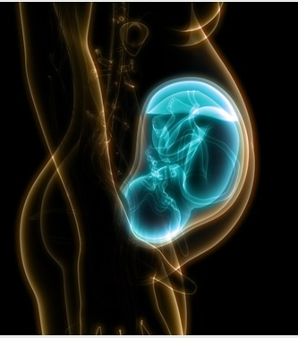
Pathogens exhibit diverse transmission mechanisms that require tailored modeling structures
Vertically-transmitted pathogens are transmitted mother-to-child in utero
Examples: HIV, Herpes simplex virus, Cytomegalovirus, Rubella, Zika

Slide 46
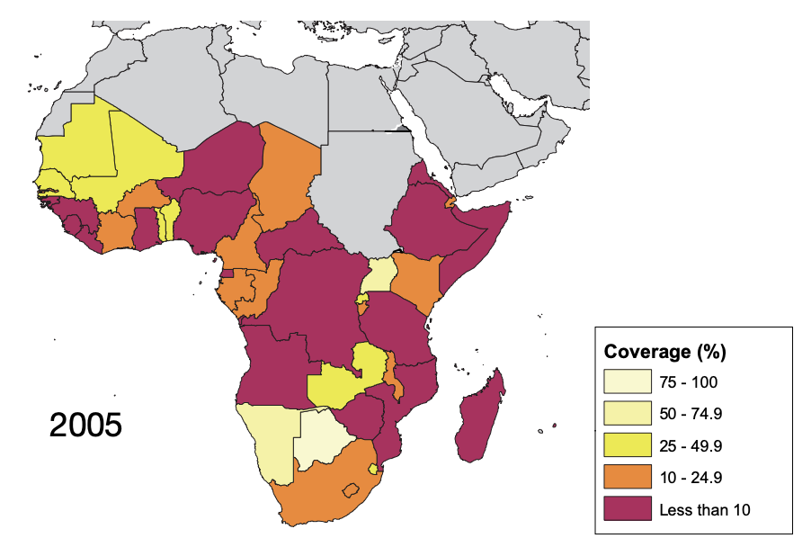
Pathogens exhibit diverse transmission mechanisms that require tailored modeling structures
Vertically-transmitted pathogens are transmitted mother-to-child in utero
Examples: HIV, Herpes simplex virus, Cytomegalovirus, Rubella, Zika
In untreated HIV+ mothers, rate of vertical transmission for HIV = 15-45%
Reduced to <1% for those on ART, though global access to ART is geographically heterogenous
ART coverage for those in need, from WHO

Slide 47
Pathogens exhibit diverse transmission mechanisms that require tailored modeling structures
Vector-borne diseases (a type of indirect transmission) are transmitted via blood-feeding arthropod (mosquitoes, ticks, fleas)
Notes:
Kissing bugs = hemiptera = true bugs

Slide 48
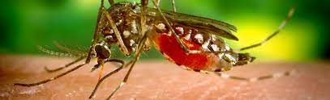
Pathogens exhibit diverse transmission mechanisms that require tailored modeling structures
Vector-borne diseases (a type of indirect transmission) are transmitted via blood-feeding arthropod (mosquitoes, ticks, fleas)
Euclidean vector: a quantity with a magnitude and direction
Epidemiological vector: an agent that carries and transmits an infectious patient into another living organism
Notes:
Kissing bugs = hemiptera = true bugs

Slide 49
Pathogens exhibit diverse transmission mechanisms that require tailored modeling structures
Vector-borne diseases (a type of indirect transmission) are transmitted via blood-feeding arthropod (mosquitoes, ticks, fleas)
Malaria: Mosquito-borne protozoan Plasmodium spp.
“Arboviruses”: Mosquito-borne viruses, including Dengue, Zika, Yellow fever virus, West Nile virus, Chikungunya virus
Sleeping sickness, also known as African trypanosomiasis: tsetse fly vector and protozoan pathogen (trypanosome)
Chagas disease: kissing bug vector and trypanosome pathogen
Plague: flea vector and bacterial pathogen (Yersinia pestis)
Notes:
Kissing bugs = hemiptera = true bugs

Slide 50
Pathogens exhibit diverse transmission mechanisms that require tailored modeling structures
Vector-borne diseases (a type of indirect transmission) are transmitted via blood-feeding arthropod (mosquitoes, ticks, fleas)
Malaria: Mosquito-borne protozoan Plasmodium spp.
“Arboviruses”: Mosquito-borne viruses, including Dengue, Zika, Yellow fever virus, West Nile virus, Chikungunya virus
Sleeping sickness, also known as African trypanosomiasis: tsetse fly vector and protozoan pathogen (trypanosome)
Chagas disease: kissing bug vector and trypanosome pathogen
Plague: flea vector and bacterial pathogen (Yersinia pestis)
Notes:
Kissing bugs = hemiptera = true bugs

Slide 51
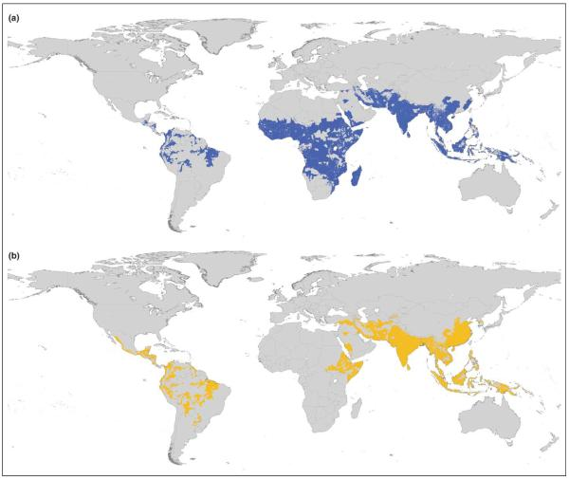
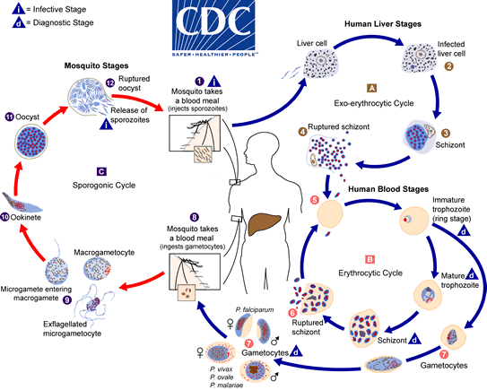
Malaria
4 main human Plasmodium parasites (falciparum, vivax, malariae, ovalae).
Over 200 Plasmodium spp. globally, infecting birds, reptiles, and other mammals (rodents, bats, primates)
Distribution Plasmodium falciparum
Distribution Plasmodium vivax
Guerra et al. 2006. Trends in Parasitology

Slide 52
Malaria
4 main human Plasmodium parasites (falciparum, vivax, malariae, ovalae).
Over 200 Plasmodium spp. globally, infecting birds, reptiles, and other mammals (rodents, bats, primates)
Distribution Plasmodium falciparum
Distribution Plasmodium vivax
Plasmodium parasites time RBC bursting such that they are at peak blood stage circulation when mosquito vectors are feeding at dusk!
Guerra et al. 2006. Trends in Parasitology

Slide 53
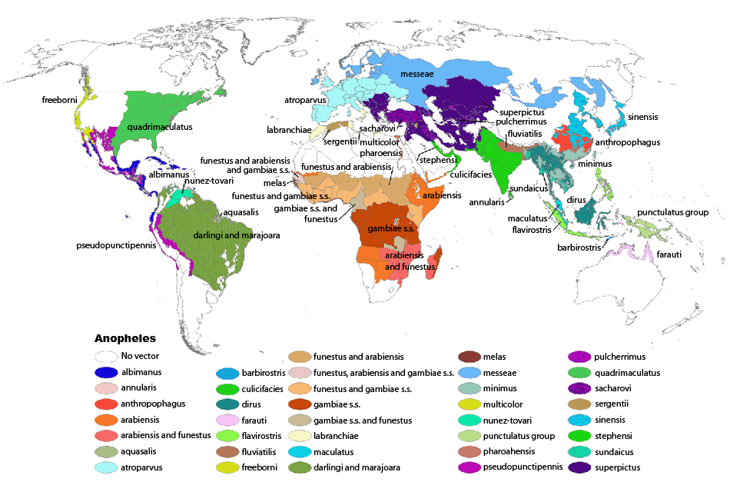
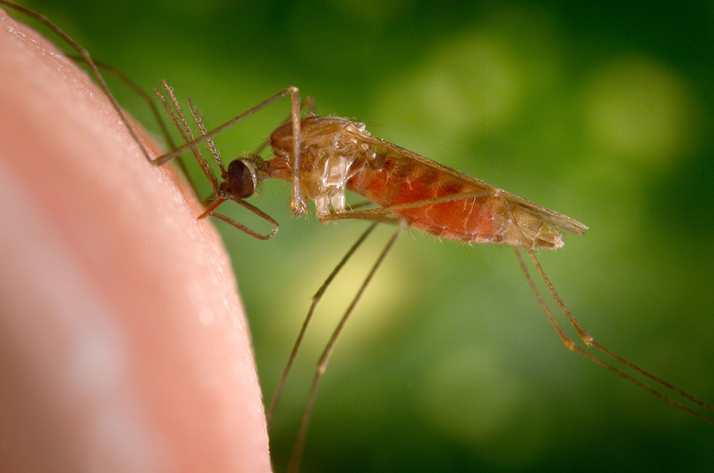
Malaria
4 main human Plasmodium parasites (falciparum, vivax, malariae, ovalae).
Over 200 Plasmodium spp. globally, infecting birds, reptiles, and other mammals (rodents, bats, primates)
>400 global species of Anopheles mosquito, >100 that can transmit human malaria
~30-40 Anopheles spp. most commonly implicated in human malaria transmission!
Kiszewksi et al. 2004. ASTMH.

Slide 54
Malaria
4 main human Plasmodium parasites (falciparum, vivax, malariae, ovalae).
Over 200 Plasmodium spp. globally, infecting birds, reptiles, and other mammals (rodents, bats, primates)
>400 global species of Anopheles mosquito, >100 that can transmit human malaria
~30-40 Anopheles spp. most commonly implicated in human malaria transmission!
Only female mosquitoes feed on blood!
Male mosquitoes feed on plant nectar.
Kiszewksi et al. 2004. ASTMH.

Slide 55
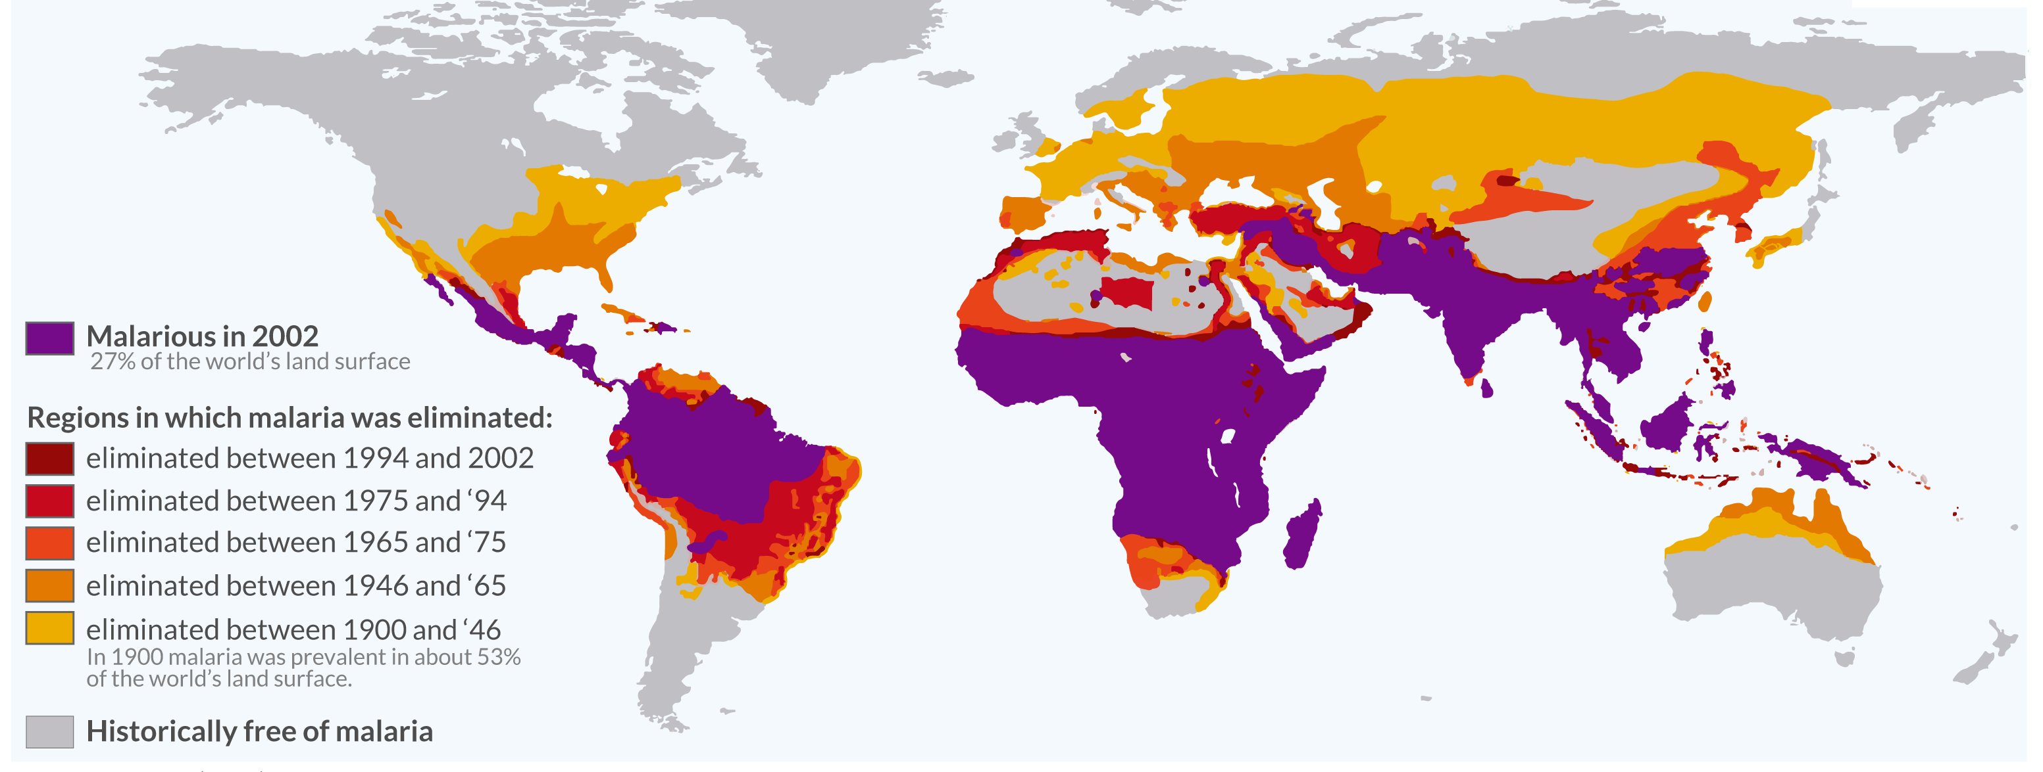
Malaria has been eliminated from many regions where it was previously endemic, including the US.
Still one of the leading causes of child mortality globally – responsible for about half a million childhood deaths a year, 80% in Africa.
OurWorldinData.org

Slide 56








Malaria models have played a critical role in public health policy for over a century.
$$σ$$
1911: British medical Dr. Sir Ronald Ross developed the first model of malaria while working in the Indian Medical Service.
He had already won the 1902 Nobel prize in physiology and medicine for discovering the life cycle of avian malaria
μ_{H}
μ_{H}
b_{H}
β_{H}
$$α$$
S_{H}
I_{H}
$$\frac{dS_{H}}{dt}=b_{H}\left(S_{H}+I_{H}\right)+ σI_{H}−β_{H}S_{H}I_{M}−μ_{H}S_{H}$$
b_{M}
S_{M}
β_{M}
I_{M}
$$\frac{dI_{H}}{dt}=β_{H}S_{H}I_{M}−σI_{H}−μ_{H}I_{H}−αI_{H}$$
μ_{M}
μ_{M}
$$\frac{dS_{M}}{dt}=b_{M}\left(S_{M}+I_{M}\right)−β_{M}S_{M}I_{H}−μ_{M}S_{M}$$
$$\frac{dI_{M}}{dt}=β_{M}S_{M}I_{H}−μ_{M}I_{M}$$

Slide 57




Malaria models have played a critical role in public health policy for over a century.
$$σ$$
1911: British medical Dr. Sir Ronald Ross developed the first model of malaria while working in the Indian Medical Service.
1957: MacDonald modified this model to include the latent period of the parasite developing in the mosquito.
He implicated the survivorship of the female mosquito as the weakest link in the life cycle!
μ_{H}
μ_{H}
b_{H}
β_{H}
$$α$$
S_{H}
I_{H}
b_{M}
β_{M}
$$γ_{M}$$
S_{M}
E_{M}
I_{M}
$$\frac{dS_{M}}{dt}=b_{M}\left(S_{M}+E_{M}+I_{M}\right)−β_{M}S_{M}I_{H}−μ_{M}S_{M}$$
μ_{M}
μ_{M}
μ_{M}
$$\frac{dE_{M}}{dt}=β_{M}S_{M}I_{H}−μ_{M}E_{M}−γ_{M}E_{M}$$
$$\frac{dI_{M}}{dt}=γ_{M}E_{M}−μ_{M}I_{M}$$

Slide 58
Malaria models have played a critical role in public health policy for over a century.
$$σ$$
1911: British medical Dr. Sir Ronald Ross developed the first model of malaria while working in the Indian Medical Service.
1957: MacDonald modified this model to include the latent period of the parasite developing in the mosquito.
This led to a widespread WHO campaign for malaria elimination using DDT in the 1950s!
Swiss chemist Paul Müller awarded 1948 Nobel Prize in medicine and physiology for discovering DDT and its impacts on arthropods
DDT played a major role in eliminating malaria from Europe and North America
DDT bioaccumulates and is carcinogenic – led to development of an environmental backlash in the US, culminating in Rachel Carson’s 1962 book Silent Spring
DDT banned globally in 2004, excepting in cases of WHO-recommended indoor residual spraying (IRS) for vector control in malaria-endemic regions
μ_{H}
μ_{H}
b_{H}
β_{H}
$$α$$
S_{H}
I_{H}
b_{M}
β_{M}
$$γ_{M}$$
S_{M}
E_{M}
I_{M}
μ_{M}
μ_{M}
μ_{M}

Slide 59
Malaria models have played a critical role in public health policy for over a century.
$$σ$$
1911: British medical Dr. Sir Ronald Ross developed the first model of malaria while working in the Indian Medical Service.
1957: MacDonald modified this model to include the latent period of the parasite developing in the mosquito.
This led to a widespread WHO campaign for malaria elimination using DDT in the 1950s!
Swiss chemist Paul Müller awarded 1948 Nobel Prize in medicine and physiology for discovering DDT and its impacts on arthropods
DDT played a major role in eliminating malaria from Europe and North America
DDT bioaccumulates and is carcinogenic – led to development of an environmental backlash in the US, culminating in Rachel Carson’s 1962 book Silent Spring
DDT banned globally in 2004, excepting in cases of WHO-recommended indoor residual spraying (IRS) for vector control in malaria-endemic regions
μ_{H}
μ_{H}
b_{H}
β_{H}
$$α$$
S_{H}
I_{H}
b_{M}
β_{M}
$$γ_{M}$$
S_{M}
E_{M}
I_{M}
μ_{M}
μ_{M}
μ_{M}

Slide 60
Malaria models have played a critical role in public health policy for over a century.
$$σ$$
1911: British medical Dr. Sir Ronald Ross developed the first model of malaria while working in the Indian Medical Service.
1957: MacDonald modified this model to include the latent period of the parasite developing in the mosquito.
This led to a widespread WHO campaign for malaria elimination using DDT in the 1950s!
Swiss chemist Paul Müller awarded 1948 Nobel Prize in medicine and physiology for discovering DDT and its impacts on arthropods
DDT played a major role in eliminating malaria from Europe and North America
DDT bioaccumulates and is carcinogenic – led to development of an environmental backlash in the US, culminating in Rachel Carson’s 1962 book Silent Spring
DDT banned globally in 2004, excepting in cases of WHO-recommended indoor residual spraying (IRS) for vector control in malaria-endemic regions
μ_{H}
μ_{H}
b_{H}
β_{H}
$$α$$
S_{H}
I_{H}
b_{M}
β_{M}
$$γ_{M}$$
S_{M}
E_{M}
I_{M}
μ_{M}
μ_{M}
μ_{M}

Slide 61
Malaria models have played a critical role in public health policy for over a century.
$$σ$$
1911: British medical Dr. Sir Ronald Ross developed the first model of malaria while working in the Indian Medical Service.
1957: MacDonald modified this model to include the latent period of the parasite developing in the mosquito.
This led to a widespread WHO campaign for malaria elimination using DDT in the 1950s!
Swiss chemist Paul Müller awarded 1948 Nobel Prize in medicine and physiology for discovering DDT and its impacts on arthropods
DDT played a major role in eliminating malaria from Europe and North America
DDT bioaccumulates and is carcinogenic – led to development of an environmental backlash in the US, culminating in Rachel Carson’s 1962 book Silent Spring
DDT banned globally in 2004, excepting in cases of WHO-recommended indoor residual spraying (IRS) for vector control in malaria-endemic regions
μ_{H}
μ_{H}
b_{H}
β_{H}
$$α$$
S_{H}
I_{H}
b_{M}
β_{M}
$$γ_{M}$$
S_{M}
E_{M}
I_{M}
μ_{M}
μ_{M}
μ_{M}

Slide 62
Malaria models have played a critical role in public health policy for over a century.
$$σ$$
1911: British medical Dr. Sir Ronald Ross developed the first model of malaria while working in the Indian Medical Service.
1957: MacDonald modified this model to include the latent period of the parasite developing in the mosquito.
This led to a widespread WHO campaign for malaria elimination using DDT in the 1950s!
Swiss chemist Paul Müller awarded 1948 Nobel Prize in medicine and physiology for discovering DDT and its impacts on arthropods
DDT played a major role in eliminating malaria from Europe and North America
DDT bioaccumulates and is carcinogenic – led to development of an environmental backlash in the US, culminating in Rachel Carson’s 1962 book Silent Spring
DDT banned globally in 2004, excepting in cases of WHO-recommended indoor residual spraying (IRS) for vector control in malaria-endemic regions
μ_{H}
μ_{H}
b_{H}
β_{H}
$$α$$
S_{H}
I_{H}
b_{M}
β_{M}
$$γ_{M}$$
S_{M}
E_{M}
I_{M}
μ_{M}
μ_{M}
μ_{M}

Slide 63

Malaria models have played a critical role in public health policy for over a century.
1911: British medical Dr. Sir Ronald Ross developed the first model of malaria while working in the Indian Medical Service.
1957: MacDonald modified this model to include the latent period of the parasite developing in the mosquito.
This led to a widespread WHO campaign for malaria elimination using DDT in the 1950s!
Swiss chemist Paul Müller awarded 1948 Nobel Prize in medicine and physiology for discovering DDT and its impacts on arthropods
DDT played a major role in eliminating malaria from Europe and North America
DDT bioaccumulates and is carcinogenic – led to development of an environmental backlash in the US, culminating in Rachel Carson’s 1962 book Silent Spring
DDT banned globally in 2004, excepting in cases of WHO-recommended indoor residual spraying (IRS) for vector control in malaria-endemic regions

Slide 64
“Ecology has a synonym which is ALL.”
Malaria models have played a critical role in public health policy for over a century.
1911: British medical Dr. Sir Ronald Ross developed the first model of malaria while working in the Indian Medical Service.
1957: MacDonald modified this model to include the latent period of the parasite developing in the mosquito.
This led to a widespread WHO campaign for malaria elimination using DDT in the 1950s!
Swiss chemist Paul Müller awarded 1948 Nobel Prize in medicine and physiology for discovering DDT and its impacts on arthropods
DDT played a major role in eliminating malaria from Europe and North America
DDT bioaccumulates and is carcinogenic – led to development of an environmental backlash in the US, culminating in Rachel Carson’s 1962 book Silent Spring
DDT banned globally in 2004, excepting in cases of WHO-recommended indoor residual spraying (IRS) for vector control in malaria-endemic regions
-John Steinbeck
The Log from the Sea of Cortez (1941)

Slide 65
Malaria models have played a critical role in public health policy for over a century.
1911: British medical Dr. Sir Ronald Ross developed the first model of malaria while working in the Indian Medical Service.
1957: MacDonald modified this model to include the latent period of the parasite in the mosquito.
This led to a widespread WHO campaign for malaria elimination using DDT in the 1950s!
1991: Anderson and May extended model to show latency in the human population.

Slide 66

Malaria models have played a critical role in public health policy for over a century.
Mandal et al. 2011. Malaria Journal.

Slide 67

Notes:
Do not modify the notes in this section to avoid tampering with the Poll Everywhere activity. More info at polleverywhere.com/support Que 2. Which statement about malaria models is accurate?
https://www.polleverywhere.com/multiple_choice_polls/bqVHsYbps6WfYfKXFhP5N?display_state=instructions&activity_state=opened&state=opened&flow=Instructor&onscreen=persist

Slide 68

Notes:
Do not modify the notes in this section to avoid tampering with the Poll Everywhere activity. More info at polleverywhere.com/support Que 2. Which statement about malaria models is accurate?
https://www.polleverywhere.com/multiple_choice_polls/bqVHsYbps6WfYfKXFhP5N?display_state=chart&activity_state=closed&state=closed&flow=Instructor&onscreen=persist

Slide 69
Notes:
Do not modify the notes in this section to avoid tampering with the Poll Everywhere activity. More info at polleverywhere.com/support Que 2. Which statement about malaria models is accurate?
https://www.polleverywhere.com/multiple_choice_polls/bqVHsYbps6WfYfKXFhP5N?display_state=chart&activity_state=closed&display=correctness&state=closed&flow=Instructor&onscreen=persist

Slide 70
Challenges to malaria elimination
High parasite diversity: sexual reproduction in 4+ Plasmodium species
Fast evolution of resistance (e.g. to drugs)
Many possible vectors! Potentially additional possible reservoirs!
Latent cases as burden is reduced
Vaccine candidates: what life stage to target?
Herd immunity threshold (HIT)

Slide 71
Challenges to malaria elimination
High parasite diversity: sexual reproduction in 4+ Plasmodium species
Fast evolution of resistance (e.g. to drugs)
Many possible vectors! Potentially additional possible reservoirs!
Latent cases as burden is reduced
Vaccine candidates: what life stage to target?
Herd immunity threshold (HIT)

Slide 72
Challenges to malaria elimination
High parasite diversity: sexual reproduction in 4+ Plasmodium species
Fast evolution of resistance (e.g. to drugs)
Many possible vectors! Potentially additional possible reservoirs!
Latent cases as burden is reduced
Vaccine candidates: what life stage to target?
Herd immunity threshold (HIT)

Slide 73
Challenges to malaria elimination
High parasite diversity: sexual reproduction in 4+ Plasmodium species
Fast evolution of resistance (e.g. to drugs)
Many possible vectors! Potentially additional possible reservoirs!
Latent cases as burden is reduced
Vaccine candidates: what life stage to target?
Herd immunity threshold (HIT)

Slide 74
Challenges to malaria elimination
High parasite diversity: sexual reproduction in 4+ Plasmodium species
Fast evolution of resistance (e.g. to drugs)
Many possible vectors! Potentially additional possible reservoirs!
Latent cases as burden is reduced
Vaccine candidates: what life stage to target?
Herd immunity threshold (HIT)

Slide 75
Pathogens exhibit diverse transmission mechanisms that require tailored modeling structures
Vector-borne diseases (a type of indirect transmission) are transmitted via blood-feeding arthropod (mosquitoes, ticks, fleas)
Malaria: Mosquito-borne protozoan Plasmodium spp.
“Arboviruses”: Mosquito-borne viruses, including Dengue, Zika, Yellow fever virus, West Nile virus, Chikungunya virus
Sleeping sickness, also known as African trypanosomiasis: tsetse fly vector and protozoan pathogen (trypanosome)
Chagas disease: kissing bug vector and trypanosome pathogen
Plague: flea vector and bacterial pathogen (Yersinia pestis)
Notes:
Kissing bugs = hemiptera = true bugs

Slide 76
Pathogens exhibit diverse transmission mechanisms that require tailored modeling structures
Vector-borne diseases (a type of indirect transmission) are transmitted via blood-feeding arthropod (mosquitoes, ticks, fleas)
Malaria: Mosquito-borne protozoan Plasmodium spp.
“Arboviruses”: Mosquito-borne viruses, including Dengue, Zika, Yellow fever virus, West Nile virus, Chikungunya virus
Sleeping sickness, also known as African trypanosomiasis: tsetse fly vector and protozoan pathogen (trypanosome)
Chagas disease: kissing bug vector and trypanosome pathogen
Plague: flea vector and bacterial pathogen (Yersinia pestis)
Plague is BOTH vector-borne and zoonotic!
Notes:
Kissing bugs = hemiptera = true bugs

Slide 77
A pathogen reservoir sources infections to a target population.
reservoir population
target population
Haydon et al. 2002. Emerging Infectious Diseases.

Slide 78
A pathogen reservoir sources infections to a target population.
reservoir population
target population
All of these populations are still called hosts!
Some are reservoir hosts and some are spillover hosts.
Haydon et al. 2002. Emerging Infectious Diseases.

Slide 79
Reservoir hosts can comprise a single species population or multiple sub-populations of different species.
maintenance
population
(> critical community size, CCS)
target population
non-maintenance population
(< CCS)
reservoir population
Haydon et al. 2002. Emerging Infectious Diseases.

Slide 80
CCS is the minimum number of hosts needed to sustain endemic transmission of a pathogen indefinitely into the future.
maintenance
population
(> critical community size, CCS)
Bartlett 1957. J of Roy Stat Soc.
Grenfell et al. 2002. Ecological Monographs.
Haydon et al. 2002. Emerging Infectious Diseases.

Slide 81
Spillover is the transmission of that pathogen between populations of different host species.
maintenance
population
(> CCS)
target population
non-maintenance population
(< CCS)
reservoir population
Haydon et al. 2002. Emerging Infectious Diseases.

Slide 82



Spillback is the term used to describe pathogen transmission back to a reservoir host from a target host.
maintenance
population
(> CCS)
target population
maintenance
population
(> CCS)
example: SARS-CoV-2 in mink – interesting case because neither humans nor mink are the original reservoir host!
reservoir population
Haydon et al. 2002. Emerging Infectious Diseases.

Slide 83


Spillback occurs among wildlife as well.
maintenance
population
(> CCS)
target population
reservoir population
example: Cattle sourced Brucella to wild ungulates in Yellowstone National Park, which now serve as a source for reinfection to cattle.
Haydon et al. 2002. Emerging Infectious Diseases.

Slide 84
Zoonosis is the transmission of a pathogen from a wildlife reservoir host to a human target host population.
maintenance
population
(> critical community size, CCS)
human population
non-maintenance population
(< CCS)
reservoir population
Haydon et al. 2002. Emerging Infectious Diseases.

Slide 85
Zoonosis is the transmission of a pathogen from a wildlife reservoir host to a human target host population.
maintenance
population
(> critical community size, CCS)
human population
non-maintenance population
(< CCS)
Can occur directly (e.g. SARS-CoV-2, rabies), or via vector (e.g. plague)
Animal hosts are not vectors!
reservoir population
Haydon et al. 2002. Emerging Infectious Diseases.

Slide 86


Zoonosis is the transmission of a pathogen from a wildlife reservoir host to a human target host population.
maintenance
population
(> CCS)
human population
non-maintenance population
(< CCS)
example: rabies
reservoir population
Lembo et al. 2008. Journal of Animal Ecology
Haydon et al. 2002. Emerging Infectious Diseases.

Slide 87

Rabies in the Serengeti is maintained in domestic dogs but can spillover to wild African carnivores.
Serengeti District, Tanzania
Cases of Rabies
Cases of Rabies
Ngorogoro District, Tanzania
Lembo et al. 2008. Journal of Animal Ecology

Slide 88
Understanding processes which maintain zoonoses in reservoirs can guide interventions to reduce spillover to humans.
maintenance
population
(> CCS)
human population
non-maintenance population
(< CCS)
reservoir population
Lembo et al. 2008. Journal of Animal Ecology
Haydon et al. 2002. Emerging Infectious Diseases.

Slide 89
Understanding processes which maintain zoonoses in reservoirs can guide interventions to reduce spillover to humans.
vaccination
maintenance
population
(> CCS)
human population
non-maintenance population
(< CCS)
reservoir population
Lembo et al. 2008. Journal of Animal Ecology
Haydon et al. 2002. Emerging Infectious Diseases.

Slide 90
Understanding processes which maintain zoonoses in reservoirs can guide interventions to reduce spillover to humans.
non-maintenance
population
(< CCS)
human population
non-maintenance population
(< CCS)
reservoir population
Lembo et al. 2008. Journal of Animal Ecology
Haydon et al. 2002. Emerging Infectious Diseases.

Slide 91

Vaccination of domestic dogs can successfully eradicate rabies from some systems.
dog cases
dog vaccination coverage
Lushasi et al. 2023. eLife.

Slide 92





Pathogens can be classed according to their host relationships.
Stage I
Stage II
Stage III
Stage IV
Stage V
Transmits exclusively in humans
Transmits exclusively in animals
Human cases from spillovers only
Stuttering chains of transmission in humans
Sustained transmission and human outbreaks
canine parvovirus
rabies virus
monkeypox (pre-2022)
Ebola virus (especially post-2014)
Tuberculosis
Lloyd-Smith et al. 2009. Science.

Slide 93

Pathogens can be classed according to their host relationships.
Stage I
Stage II
Stage III
Stage IV
Stage V
Transmits exclusively in humans
Transmits exclusively in animals
Human cases from spillovers only
Stuttering chains of transmission in humans
Sustained transmission and human outbreaks
canine parvovirus
rabies virus
monkeypox (pre-2022)
Ebola virus (especially post-2014)
Tuberculosis
R₀ < 1
R₀ $≈$ 1
R₀ > 1
Zoonotic pathogens can be classed according to their R₀ in humans.
Lloyd-Smith et al. 2009. Science.

Slide 94



Most stage V pathogens once had an animal origin, as well!
Stage V
Transmits exclusively in humans
HIV
Sharp & Hahn. 2011. Cold Spring Harb Perspect Med.

Slide 95

The force of infection (FOI), $λ$, is the rate at which susceptibles become infected
For a single host pathogen: ${λ=R}_{0}\frac{I}{N}$
(FOI = R₀ * proportion infected)
$≈$ mirror image of${ R}_{E}{=R}_{0}\frac{S}{N}$
Also a finger on the epidemic pulse
For multi-host pathogens, we can define the spillover force of infection
Comprised of:
Infectiousness of the reservoir
Reservoir-human contact rates
Susceptibility in the human host
Lloyd-Smith et al. 2009. Science.

Slide 96
The force of infection (FOI), $λ$, is the rate at which susceptibles become infected
For a single host pathogen: ${λ=R}_{0}\frac{I}{N}$
(FOI = R₀ * proportion infected)
$≈$ mirror image of${ R}_{E}{=R}_{0}\frac{S}{N}$
Also a finger on the epidemic pulse
For multi-host pathogens, we can define the spillover force of infection
Comprised of:
Infectiousness of the reservoir
Reservoir-human contact rates
Susceptibility in the human host
Lloyd-Smith et al. 2009. Science.

Slide 97
The force of infection (FOI), $λ$, is the rate at which susceptibles become infected
For a single host pathogen: ${λ=R}_{0}\frac{I}{N}$
(FOI = R₀ * proportion infected)
$≈$ mirror image of${ R}_{E}{=R}_{0}\frac{S}{N}$
Also a finger on the epidemic pulse
For multi-host pathogens, we can define the spillover force of infection
Comprised of:
Infectiousness of the reservoir
Reservoir-human contact rates
Susceptibility in the human host
Lloyd-Smith et al. 2009. Science.

Slide 98
The force of infection (FOI), $λ$, is the rate at which susceptibles become infected
For a single host pathogen: ${λ=R}_{0}\frac{I}{N}$
(FOI = R₀ * proportion infected)
$≈$ mirror image of${ R}_{E}{=R}_{0}\frac{S}{N}$
Also a finger on the epidemic pulse
For multi-host pathogens, we can define the spillover force of infection
Comprised of:
Infectiousness of the reservoir
Reservoir-human contact rates
Susceptibility in the human host
Lloyd-Smith et al. 2009. Science.

Slide 99
The force of infection (FOI), $λ$, is the rate at which susceptibles become infected
For a single host pathogen: ${λ=R}_{0}\frac{I}{N}$
(FOI = R₀ * proportion infected)
$≈$ mirror image of${ R}_{E}{=R}_{0}\frac{S}{N}$
Also a finger on the epidemic pulse
For multi-host pathogens, we can define the spillover force of infection
Comprised of:
Infectiousness of the reservoir
Reservoir-human contact rates
Susceptibility in the human host
Keeling & Gilligan model $λ_{H}$ for plague as proportional to the abundance of free-living infected fleas.
Lloyd-Smith et al. 2009. Science.

Slide 100

Fleas get infected from rats.
Humans get infected from free-living infected fleas!
“…from April 18 onwards, quantities of dead or dying rats were found in factories and warehouses…From the outer suburbs to the center of the town, in all the byways where the doctor's duties took him, in every thoroughfare, rats were piled up in garbage cans or lying in long lines in the gutters…On the fourth day the rats began to come out and die in batches…”
--La Peste, Albert Camus (1948)
Plague is BOTH vector-borne and zoonotic!
Keeling and Gilligan. 2000. Nature.

Slide 101
Humans get infected from free-living infected fleas!
“…from April 18 onwards, quantities of dead or dying rats were found in factories and warehouses…From the outer suburbs to the center of the town, in all the byways where the doctor's duties took him, in every thoroughfare, rats were piled up in garbage cans or lying in long lines in the gutters…On the fourth day the rats began to come out and die in batches…”
--La Peste, Albert Camus (1948)
Plague is BOTH vector-borne and zoonotic!
Keeling and Gilligan. 2000. Nature.

Slide 102

Zoonosis is a series of improbable events.
Plowright et al. 2017. Nature Reviews Microbiology.

Slide 103

Bottlenecks to spillover.
Plowright et al. 2017. Nature Reviews Microbiology.

